Slide 1
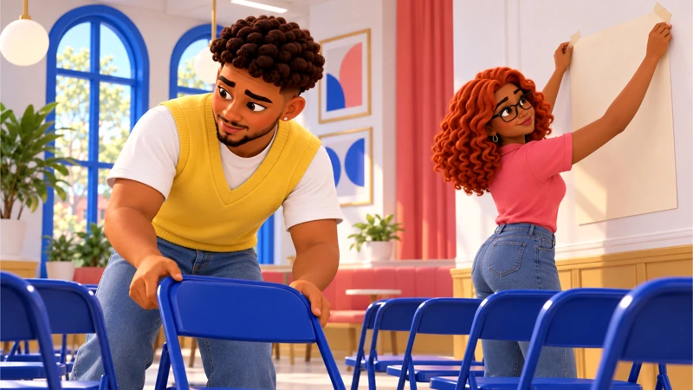
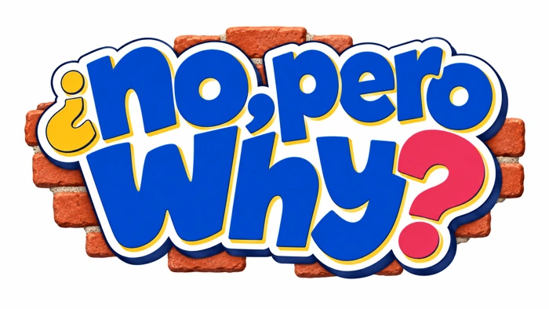
No, Pero Why?
Case 1 1
Before you repost
Casebook 1
What can a screenshot actually prove?
Your questions. The evidence. A response you can explain.
Notes:
Workshops 1–2. Each session is 45 minutes. Use the original source to separate a claim from a supported fact, then write an update that helps people act.
Prepare the case workbook, evidence A–C, and response supports. Default to text and original character scenes. Film and social clips are optional and require preview.
Workshop 1 timing: 5 min Read the post, 8 min Build the question, 12 min Open the receipts, 12 min Check beyond the post, 8 min Revise the take
Curriculum: grades 6–12, original fictional Common Room evidence. No personal disclosure or public posting required.
Primary sources:
Entman, Framing: https://fbaum.unc.edu/teaching/articles/J-Communication-1993-Entman.pdf
The research behind our question about selection and emphasis.
SPJ, Code of Ethics: https://www.spj.org/spj-code-of-ethics/
Professional guidance on verification, context and corrections.
CAST UDL: https://udlguidelines.cast.org/
NAMLE principles: https://namle.org/resources/core-principles/

Slide 2
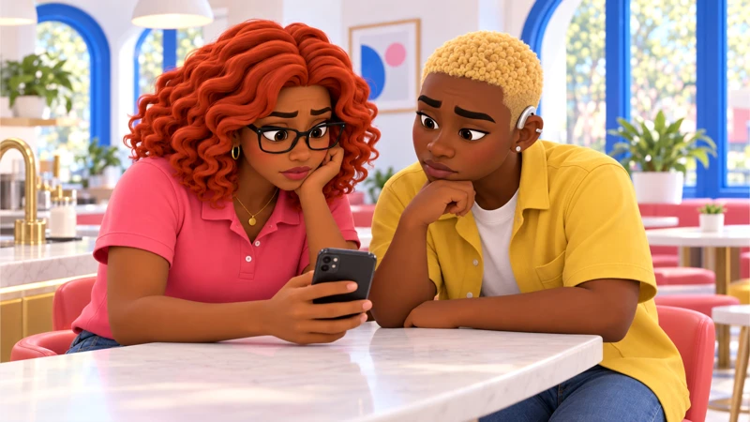
No, Pero Why?
Case 1 2
Here is what happened
The screening is booked. Then a cropped clip lands in the group chat.
Gia wants to warn people before they travel. Mateo wants the post to be wrong. You have a little time to check before changing everyone’s plans.
Notes:
Read the full premise from the workbook. The Common Room is a bookshop’s shared event space in Fort Greene. Mateo, 22, booked it for the crew’s first neighborhood screening. Gia, 21, is squeezing setup between class and a café shift. Jordy, 20, is checking the projector and captions. Then a cropped meeting clip arrives. Its caption says the room is shutting down. Gia wants to warn people before they travel. Mateo wants the post to be wrong. You have ten minutes to give people an update, but you do not have to guess.
Warm-up: What do you know, and what are you assuming? Let students write before discussing. Do not require personal stories.
Curriculum: grades 6–12, original fictional Common Room evidence. No personal disclosure or public posting required.
Primary sources:
Entman, Framing: https://fbaum.unc.edu/teaching/articles/J-Communication-1993-Entman.pdf
The research behind our question about selection and emphasis.
SPJ, Code of Ethics: https://www.spj.org/spj-code-of-ethics/
Professional guidance on verification, context and corrections.
CAST UDL: https://udlguidelines.cast.org/
NAMLE principles: https://namle.org/resources/core-principles/

Slide 3
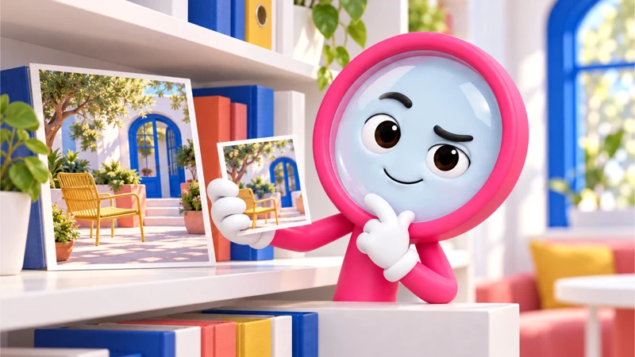
No, Pero Why?
Case 1 3
Lupa has a question
What can a screenshot actually prove?
What would you need to check before deciding?
Notes:
Learning target: Use the original source to separate a claim from a supported fact, then write an update that helps people act.
Give students the three documents on separate pages. Read the transcript aloud. Use “The post claims __. The original says __. We still need __.”
Ask students to turn an assumption into a checkable question. The companion prompts inquiry; it does not provide the correct position.
Curriculum: grades 6–12, original fictional Common Room evidence. No personal disclosure or public posting required.
Primary sources:
Entman, Framing: https://fbaum.unc.edu/teaching/articles/J-Communication-1993-Entman.pdf
The research behind our question about selection and emphasis.
SPJ, Code of Ethics: https://www.spj.org/spj-code-of-ethics/
Professional guidance on verification, context and corrections.
CAST UDL: https://udlguidelines.cast.org/
NAMLE principles: https://namle.org/resources/core-principles/

Slide 4
No, Pero Why?
Case 1 4
Two records, two different jobs
A. The post
B. The full update
“They’re removing access tonight. Screening cancelled?” The attached clip starts with “we are removing access” and ends before the next sentence.
“The side-door reader is broken. We are removing access through that reader tonight. Existing room bookings remain in place. Use the staffed front entrance while we repair it.”
What can this establish?
What can this establish?
Notes:
Original fictional case records for classroom analysis. The post: It shows a claim being shared. It does not confirm the cancellation.
The full update: It explains the access change. It does not tell us whether every visitor can use the temporary entrance.
Students mark one exact detail, then connect it to a claim. Do not equate the fact that a statement was published with proof that it is accurate.
Curriculum: grades 6–12, original fictional Common Room evidence. No personal disclosure or public posting required.
Primary sources:
Entman, Framing: https://fbaum.unc.edu/teaching/articles/J-Communication-1993-Entman.pdf
The research behind our question about selection and emphasis.
SPJ, Code of Ethics: https://www.spj.org/spj-code-of-ethics/
Professional guidance on verification, context and corrections.
CAST UDL: https://udlguidelines.cast.org/
NAMLE principles: https://namle.org/resources/core-principles/

Slide 5
No, Pero Why?
Case 1 5
One more piece of the picture
C. The booking email
Friday, 6–9 p.m. Screening confirmed. Front entrance: step-free. Staff member at the desk from 5:30 p.m. Contact the coordinator for arrival support.
What this leaves open
It supports the event details. The crew should still check and communicate any access needs.
Notes:
Discuss scope before a conclusion. Calling the clip fake skips the actual problem. The clip is real in the story; its missing context changes its meaning.
A student identifies the broken side-door reader, keeps the screening separate from the entrance change, and names an unresolved access need.
Case 2: the federal evaluation rule is a paraphrase, not a verbatim quotation. IDEA evaluates disability and educational needs. It does not prescribe every classroom quiz.
Curriculum: grades 6–12, original fictional Common Room evidence. No personal disclosure or public posting required.
Primary sources:
Entman, Framing: https://fbaum.unc.edu/teaching/articles/J-Communication-1993-Entman.pdf
The research behind our question about selection and emphasis.
SPJ, Code of Ethics: https://www.spj.org/spj-code-of-ethics/
Professional guidance on verification, context and corrections.
CAST UDL: https://udlguidelines.cast.org/
NAMLE principles: https://namle.org/resources/core-principles/

Slide 6
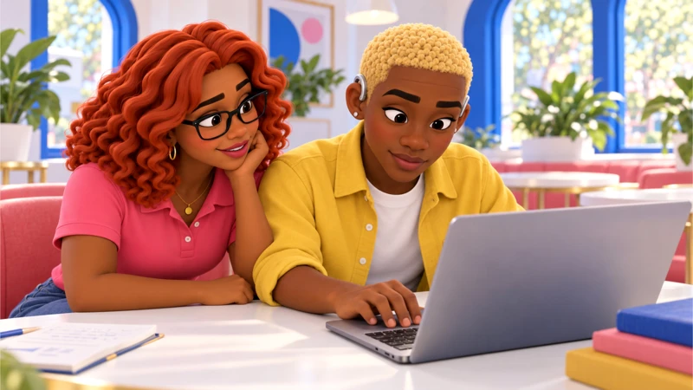
No, Pero Why?
Case 1 6
What changed in your first take?
The evidence supports…
We still need to know…
I changed my view because…
Notes:
Close session 1. Use a private exit response. A student identifies the broken side-door reader, keeps the screening separate from the entrance change, and names an unresolved access need.
For more depth: Compare how two different captions frame the same clip. Explain why a correction should reach the original audience. Add a source-authority check.
At the next session, recall the evidence before discussing decisions.
Curriculum: grades 6–12, original fictional Common Room evidence. No personal disclosure or public posting required.
Primary sources:
Entman, Framing: https://fbaum.unc.edu/teaching/articles/J-Communication-1993-Entman.pdf
The research behind our question about selection and emphasis.
SPJ, Code of Ethics: https://www.spj.org/spj-code-of-ethics/
Professional guidance on verification, context and corrections.
CAST UDL: https://udlguidelines.cast.org/
NAMLE principles: https://namle.org/resources/core-principles/

Slide 7
No, Pero Why?
Case 1 7
What do you send while checking?
A. Cancel before people travel.
B. We’re checking the original. Hold your plans for a moment.
C. The post is fake. Ignore it.
Notes:
Session 2. Students choose individually, justify, then compare. A student may revise.
A: Gia’s message gets people to change plans before the booking is checked. A fast warning can create the very disruption you were trying to prevent.
B: Jordy posts a clear holding message. It names the uncertainty and promises a follow-up without repeating the claim as fact.
C: Mateo feels relieved, but “fake” is broader than the evidence. The clip is real; the missing context is the problem.
Curriculum: grades 6–12, original fictional Common Room evidence. No personal disclosure or public posting required.
Primary sources:
Entman, Framing: https://fbaum.unc.edu/teaching/articles/J-Communication-1993-Entman.pdf
The research behind our question about selection and emphasis.
SPJ, Code of Ethics: https://www.spj.org/spj-code-of-ethics/
Professional guidance on verification, context and corrections.
CAST UDL: https://udlguidelines.cast.org/
NAMLE principles: https://namle.org/resources/core-principles/

Slide 8
No, Pero Why?
Case 1 8
You have the full update. Which correction holds up?
A. Tonight is on. The side-door reader is out; use the staffed front entrance.
B. Nothing is changing.
C. The poster deliberately lied.
Notes:
Use evidence, likely effects and institutional authority to evaluate each response.
A: Gia adds the booking time and original update. People can decide what to do, and the access change stays visible.
B: That erases the entrance change. Sami could arrive at the wrong door even though the event is happening.
C: The sources tell you what the clip omitted, not what the poster knew. Correct the claim without inventing a motive.
Choice 1B names uncertainty while checking. Choice 2A corrects the claim and preserves the entrance change. Other choices overstate, erase context or invent intent.
Curriculum: grades 6–12, original fictional Common Room evidence. No personal disclosure or public posting required.
Primary sources:
Entman, Framing: https://fbaum.unc.edu/teaching/articles/J-Communication-1993-Entman.pdf
The research behind our question about selection and emphasis.
SPJ, Code of Ethics: https://www.spj.org/spj-code-of-ethics/
Professional guidance on verification, context and corrections.
CAST UDL: https://udlguidelines.cast.org/
NAMLE principles: https://namle.org/resources/core-principles/

Slide 9
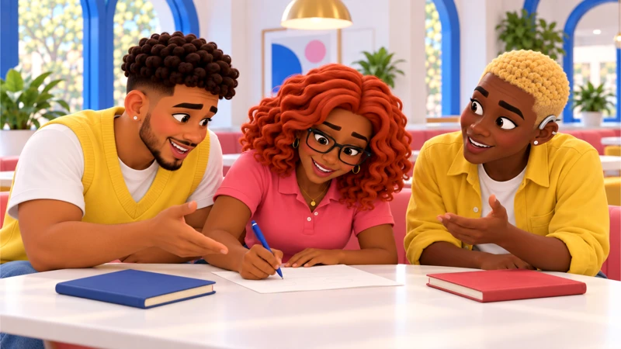
No, Pero Why?
Case 1 9
Make something someone can use
Write a group-chat update someone can use before leaving home.
Confirm the booking, explain the entrance change, link the original and say where to ask about access.
Writing, audio or a paper draft all work.
Notes:
Independent or paired drafting: 15 minutes. Use the workbook for a first draft and evidence reference. A spoken response can be dictated or transcribed. Respect individual support plans. Public posting is never required.
The final update includes a confirmed event, entrance change, supporting source, useful next step and no invented motive.
Curriculum: grades 6–12, original fictional Common Room evidence. No personal disclosure or public posting required.
Primary sources:
Entman, Framing: https://fbaum.unc.edu/teaching/articles/J-Communication-1993-Entman.pdf
The research behind our question about selection and emphasis.
SPJ, Code of Ethics: https://www.spj.org/spj-code-of-ethics/
Professional guidance on verification, context and corrections.
CAST UDL: https://udlguidelines.cast.org/
NAMLE principles: https://namle.org/resources/core-principles/

Slide 10
No, Pero Why?
Case 1 10
One response to test
Tonight’s screening is still on, 6–9 p.m. The clip was about the broken side-door reader. Use the staffed, step-free front entrance. The booking email and full update confirm this. Need help arriving? Contact the coordinator before you travel.
Which part is supported? What would you revise?
Notes:
Show after students draft, or earlier as a model when support is needed. This is a possible response, not a script to copy. Have students mark a claim, supporting detail, limit and next step. Case 4 can support other recommendations.
Choice 1B names uncertainty while checking. Choice 2A corrects the claim and preserves the entrance change. Other choices overstate, erase context or invent intent.
College extension: Compare Entman’s selection and salience with the practical holding statement. Discuss how a community organization could evaluate whether its correction reached affected people.
Curriculum: grades 6–12, original fictional Common Room evidence. No personal disclosure or public posting required.
Primary sources:
Entman, Framing: https://fbaum.unc.edu/teaching/articles/J-Communication-1993-Entman.pdf
The research behind our question about selection and emphasis.
SPJ, Code of Ethics: https://www.spj.org/spj-code-of-ethics/
Professional guidance on verification, context and corrections.
CAST UDL: https://udlguidelines.cast.org/
NAMLE principles: https://namle.org/resources/core-principles/

Slide 11
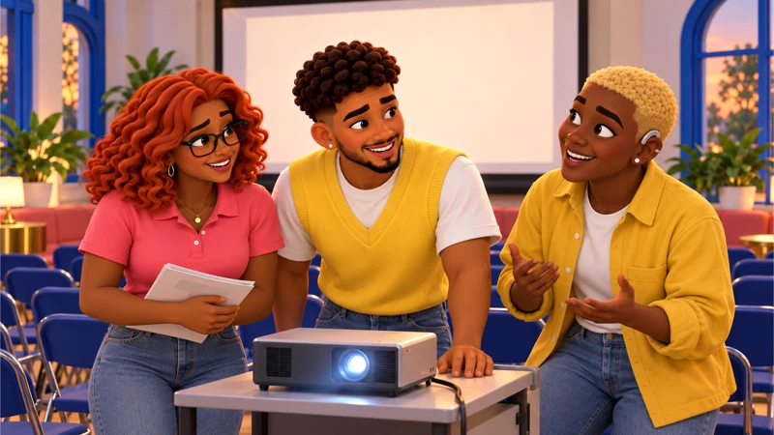
No, Pero Why?
Case 1 11
Where could this go next?
Ask a teacher or event organizer how updates reach people who do not use the main group chat.
A private question or draft counts. You choose how to take part.
Notes:
Use a mock or private route by default. Authentic activity is voluntary and educator-managed. No outside accounts, travel, interviews, petition signatures or political declarations required.
Ask a partner for one good-faith question, then revise.
Curriculum: grades 6–12, original fictional Common Room evidence. No personal disclosure or public posting required.
Primary sources:
Entman, Framing: https://fbaum.unc.edu/teaching/articles/J-Communication-1993-Entman.pdf
The research behind our question about selection and emphasis.
SPJ, Code of Ethics: https://www.spj.org/spj-code-of-ethics/
Professional guidance on verification, context and corrections.
CAST UDL: https://udlguidelines.cast.org/
NAMLE principles: https://namle.org/resources/core-principles/

Slide 12
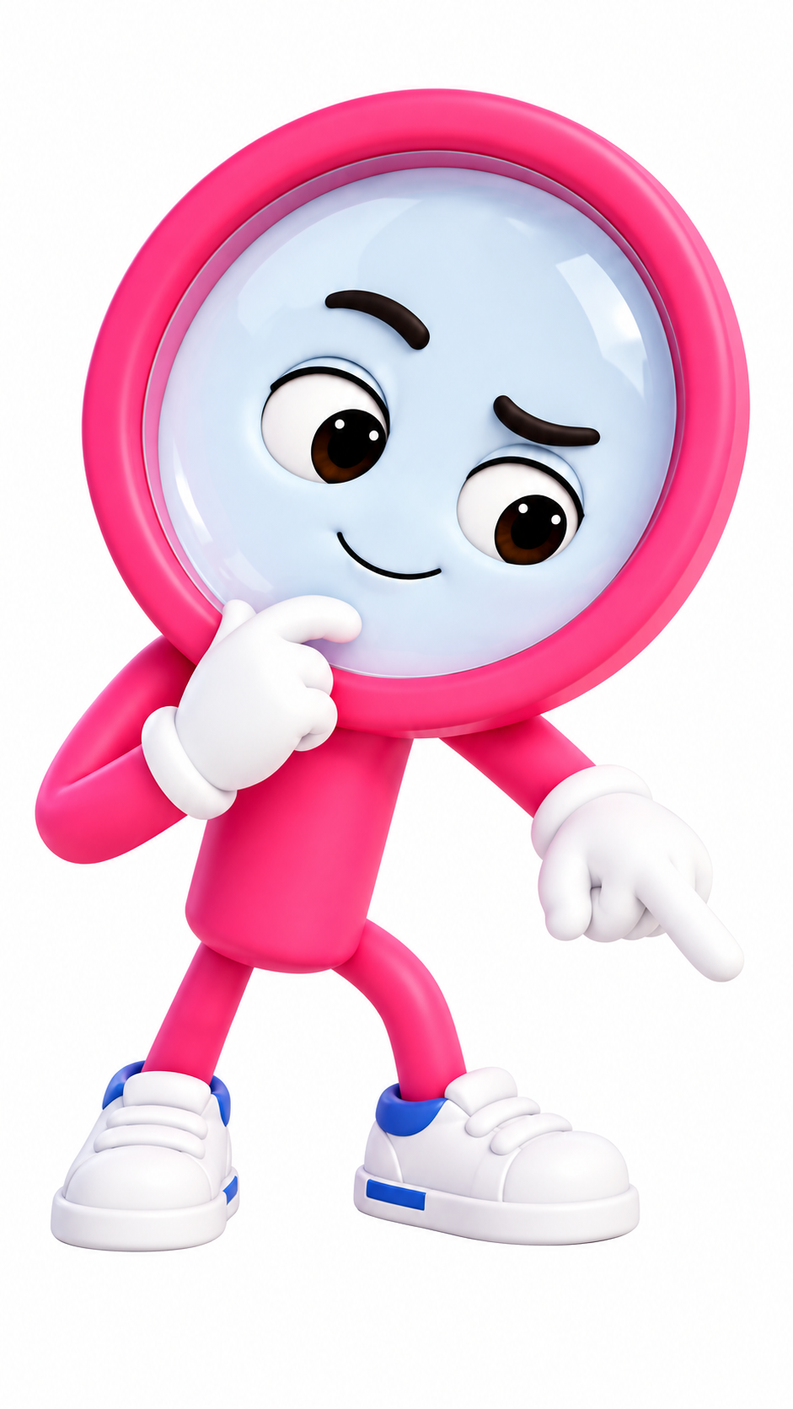
No, Pero Why?
Case 1 12
Your take, with something behind it
My claim is clear.
I can point to evidence.
I named a limit.
Someone knows the next step.
I can explain my revision.
Keep the question going.
Sources and teaching notes are in this deck.
Notes:
Assess evidence, reasoning, perspective/authority, communication and revision, each on the guide’s 1–3 scale if a score is needed. Do not assess political agreement or performance style.
Exit: explain one revision and what prompted it.
Research foundations: NCSS C3 Framework https://www.socialstudies.org/sites/default/files/c3/c3-framework-for-social-studies-rev0617.pdf
Digital Inquiry Group https://cor.inquirygroup.org/curriculum/collections/teaching-lateral-reading/
5 min: Recall the evidence — Pairs reconstruct the story without reopening the screenshot. Compare against the full update.
10 min: Try two choices — Use both decisions in the case. Ask what each message could make a reader do before leaving home.
15 min: Draft and test — Write a 50–80 word update. Another pair plays a visitor: Where do I go? When? What if I need support?
10 min: Revise with a reason — Add a source and replace any claim about the poster’s motive. Students mark one edit and explain it.
5 min: Close the loop — Choose a private action: save the original, ask the coordinator or share the corrected draft with a teacher.
Curriculum: grades 6–12, original fictional Common Room evidence. No personal disclosure or public posting required.
Primary sources:
Entman, Framing: https://fbaum.unc.edu/teaching/articles/J-Communication-1993-Entman.pdf
The research behind our question about selection and emphasis.
SPJ, Code of Ethics: https://www.spj.org/spj-code-of-ethics/
Professional guidance on verification, context and corrections.
CAST UDL: https://udlguidelines.cast.org/
NAMLE principles: https://namle.org/resources/core-principles/

Slide 13
No, Pero Why?
Case 1 13
The method behind the move
Source verification + claim, evidence, reasoning
1 Claim
2 Evidence
Write exactly what the post asks people to believe.
Find the words about the side-door reader. Compare them with the booking email.
3 Reasoning
4 Limit
Explain why an entrance change does not establish an event cancellation.
What do we still need to check about the temporary entrance?
Notes:
Digital Inquiry Group: https://cor.inquirygroup.org/curriculum/collections/intro-lessons/
Toulmin argument, Purdue OWL: https://owl.purdue.edu/owl/general_writing/academic_writing/historical_perspectives_on_argumentation/toulmin_argument.html
These methods are classroom adaptations. Give students the three documents on separate pages. Read the transcript aloud. Use “The post claims __. The original says __. We still need __.”
Grades 9–12: Compare how two different captions frame the same clip. Explain why a correction should reach the original audience. Add a source-authority check.
Curriculum: grades 6–12, original fictional Common Room evidence. No personal disclosure or public posting required.
Primary sources:
Entman, Framing: https://fbaum.unc.edu/teaching/articles/J-Communication-1993-Entman.pdf
The research behind our question about selection and emphasis.
SPJ, Code of Ethics: https://www.spj.org/spj-code-of-ethics/
Professional guidance on verification, context and corrections.
CAST UDL: https://udlguidelines.cast.org/
NAMLE principles: https://namle.org/resources/core-principles/

Slide 14
No, Pero Why?
Case 1 14
The workshop can go deeper
Grades 6–8
Give students the three documents on separate pages. Read the transcript aloud. Use “The post claims __. The original says __. We still need __.”
Grades 9–12
Compare how two different captions frame the same clip. Explain why a correction should reach the original audience. Add a source-authority check.
Course options
Pre-AP close analysis. AP argument and rhetoric. MYP purposeful texts. DP nonliterary textual analysis. Honors independent corroboration.
Notes:
Teacher reference. Select the actual grade/year descriptor in the curriculum crosswalk. These are independently designed practice tasks, not official assessment components or full course certification. Each route requires submitted writing and reasoning. Discussion targets require an actual exchange.
Curriculum: grades 6–12, original fictional Common Room evidence. No personal disclosure or public posting required.
Primary sources:
Entman, Framing: https://fbaum.unc.edu/teaching/articles/J-Communication-1993-Entman.pdf
The research behind our question about selection and emphasis.
SPJ, Code of Ethics: https://www.spj.org/spj-code-of-ethics/
Professional guidance on verification, context and corrections.
CAST UDL: https://udlguidelines.cast.org/
NAMLE principles: https://namle.org/resources/core-principles/

