Slide 1
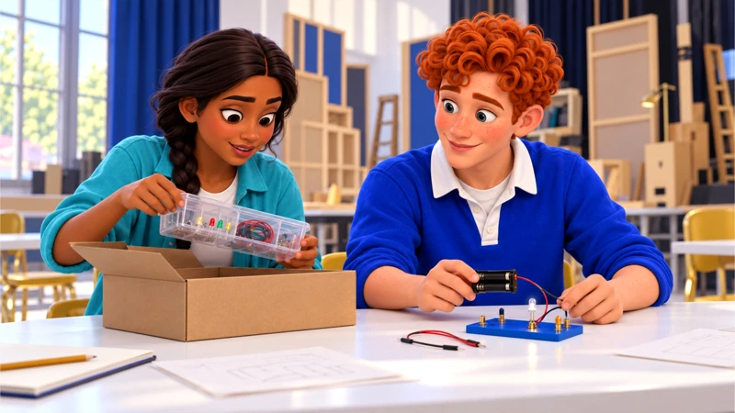

No, Pero Why?
Case 2 1
Same test. More questions
Casebook 1
Does this task show what someone knows?
Your questions. The evidence. A response you can explain.
Notes:
Workshops 3–4. Each session is 45 minutes. Compare observations with a learning goal and ask for support without diagnosing a classmate.
Prepare the case workbook, evidence A–C, and response supports. Default to text and original character scenes. Film and social clips are optional and require preview.
Workshop 1 timing: 5 min Meet the task, 10 min Compare observations, 10 min Ask Dec first, 15 min Change one feature, 5 min Exit with a limit
Curriculum: grades 6–12, original fictional Common Room evidence. No personal disclosure or public posting required.
Primary sources:
IDEA, 34 CFR § 300.304: https://sites.ed.gov/idea/regs/b/d/300.304
Federal requirements for special-education evaluation procedures.
CAST, UDL Guidelines 3.0: https://udlguidelines.cast.org/
Design guidance for reducing barriers while keeping learning goals clear.
CAST UDL: https://udlguidelines.cast.org/
NAMLE principles: https://namle.org/resources/core-principles/

Slide 2
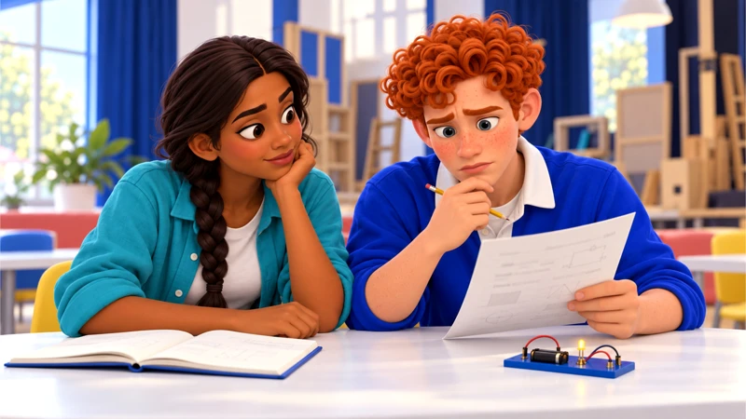
No, Pero Why?
Case 2 2
Here is what happened
Dec can explain the circuit aloud. The written sheet tells a different story.
Anika suggests repeating the same timed practice. Dec says the crowded layout is hard to follow. Pauta wants to check the learning goal first.
Notes:
Read the full premise from the workbook. Anika, 16, and Dec, 17, are studying before theatre rehearsal. They are building a light circuit for a school set. Dec explains the route out loud, then loses track of the crowded written instructions. Anika thinks they should just run the same practice test again. Mari, 19, is on her bookshop break. She recognizes the frustration, but she does not assume Dec’s difficulty is the same as hers. He wants help with this task, not a diagnosis from the group chat. Pauta opens the assignment so you can work out what it actually measures.
Warm-up: What do you know, and what are you assuming? Let students write before discussing. Do not require personal stories.
Curriculum: grades 6–12, original fictional Common Room evidence. No personal disclosure or public posting required.
Primary sources:
IDEA, 34 CFR § 300.304: https://sites.ed.gov/idea/regs/b/d/300.304
Federal requirements for special-education evaluation procedures.
CAST, UDL Guidelines 3.0: https://udlguidelines.cast.org/
Design guidance for reducing barriers while keeping learning goals clear.
CAST UDL: https://udlguidelines.cast.org/
NAMLE principles: https://namle.org/resources/core-principles/

Slide 3
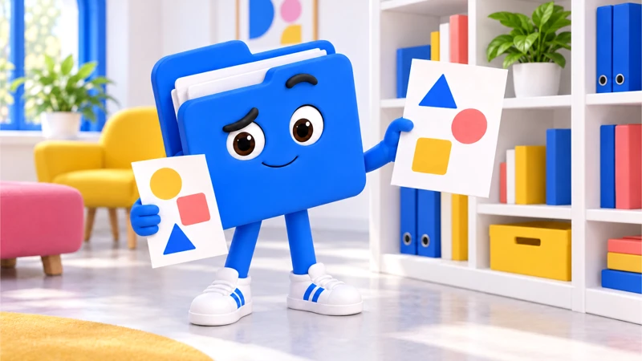
No, Pero Why?
Case 2 3
Pauta has a question
Does this task show what someone knows?
What would you need to check before deciding?
Notes:
Learning target: Compare observations with a learning goal and ask for support without diagnosing a classmate.
Provide “I noticed __” and “Could we talk about __?” stems. Read legal vocabulary aloud. Use a large circuit diagram or a paper sketch rather than timed reading.
Ask students to turn an assumption into a checkable question. The companion prompts inquiry; it does not provide the correct position.
Curriculum: grades 6–12, original fictional Common Room evidence. No personal disclosure or public posting required.
Primary sources:
IDEA, 34 CFR § 300.304: https://sites.ed.gov/idea/regs/b/d/300.304
Federal requirements for special-education evaluation procedures.
CAST, UDL Guidelines 3.0: https://udlguidelines.cast.org/
Design guidance for reducing barriers while keeping learning goals clear.
CAST UDL: https://udlguidelines.cast.org/
NAMLE principles: https://namle.org/resources/core-principles/

Slide 4
No, Pero Why?
Case 2 4
Two records, two different jobs
A. The assignment
B. Dec’s explanation
Goal: explain how a simple circuit works. The practice sheet has six dense paragraphs and one small diagram. Speed is not listed as a learning goal.
Dec correctly traces the circuit aloud. On the written sheet, he skips a line and answers a different question. He says the layout is hard to follow.
What can this establish?
What can this establish?
Notes:
Original fictional case records for classroom analysis. The assignment: It gives you a reason to question the format, not permission to change a teacher’s assessment rules on your own.
Dec’s explanation: A second observation complicates the first score. It does not establish a diagnosis.
Students mark one exact detail, then connect it to a claim. Do not equate the fact that a statement was published with proof that it is accurate.
Curriculum: grades 6–12, original fictional Common Room evidence. No personal disclosure or public posting required.
Primary sources:
IDEA, 34 CFR § 300.304: https://sites.ed.gov/idea/regs/b/d/300.304
Federal requirements for special-education evaluation procedures.
CAST, UDL Guidelines 3.0: https://udlguidelines.cast.org/
Design guidance for reducing barriers while keeping learning goals clear.
CAST UDL: https://udlguidelines.cast.org/
NAMLE principles: https://namle.org/resources/core-principles/

Slide 5
No, Pero Why?
Case 2 5
One more piece of the picture
C. The evaluation rule
Under IDEA evaluation procedures, a public agency must gather information with varied tools and strategies. One measure cannot be the sole basis for disability eligibility or an appropriate educational program.
What this leaves open
This concerns IDEA evaluations. It does not mean every classroom quiz has to be replaced or every struggling student qualifies.
Notes:
Discuss scope before a conclusion. A failed quiz does not prove a disability, guarantee an IEP or establish a legal violation. Friends can support a request without diagnosing anyone.
The learner connects a possible layout barrier to an observation without assigning Dec a disability or deciding eligibility.
Case 2: the federal evaluation rule is a paraphrase, not a verbatim quotation. IDEA evaluates disability and educational needs. It does not prescribe every classroom quiz.
Curriculum: grades 6–12, original fictional Common Room evidence. No personal disclosure or public posting required.
Primary sources:
IDEA, 34 CFR § 300.304: https://sites.ed.gov/idea/regs/b/d/300.304
Federal requirements for special-education evaluation procedures.
CAST, UDL Guidelines 3.0: https://udlguidelines.cast.org/
Design guidance for reducing barriers while keeping learning goals clear.
CAST UDL: https://udlguidelines.cast.org/
NAMLE principles: https://namle.org/resources/core-principles/

Slide 6
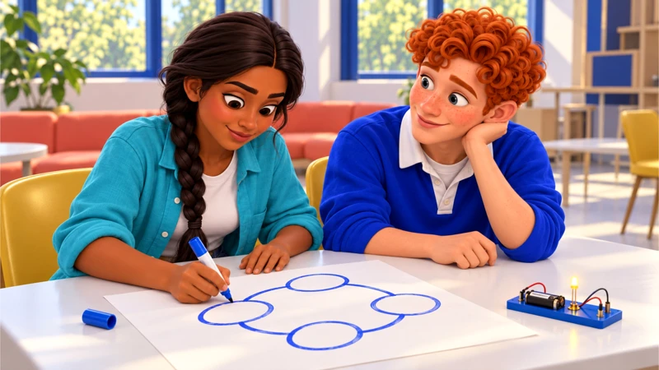
No, Pero Why?
Case 2 6
What changed in your first take?
The evidence supports…
We still need to know…
I changed my view because…
Notes:
Close session 3. Use a private exit response. The learner connects a possible layout barrier to an observation without assigning Dec a disability or deciding eligibility.
For more depth: Distinguish classroom practice, IDEA evaluation, eligibility and an IEP. Explain why one observation may justify a question but does not settle any of those steps.
At the next session, recall the evidence before discussing decisions.
Curriculum: grades 6–12, original fictional Common Room evidence. No personal disclosure or public posting required.
Primary sources:
IDEA, 34 CFR § 300.304: https://sites.ed.gov/idea/regs/b/d/300.304
Federal requirements for special-education evaluation procedures.
CAST, UDL Guidelines 3.0: https://udlguidelines.cast.org/
Design guidance for reducing barriers while keeping learning goals clear.
CAST UDL: https://udlguidelines.cast.org/
NAMLE principles: https://namle.org/resources/core-principles/

Slide 7
No, Pero Why?
Case 2 7
What do you try at the study table?
A. Run the identical timed sheet again.
B. Let Dec explain with a larger diagram, then compare the reasoning.
C. Tell Dec he definitely needs an IEP.
Notes:
Session 4. Students choose individually, justify, then compare. A student may revise.
A: Repetition might help some skills, but you have not checked the layout barrier Dec described. Anika asks what the repeat is meant to teach.
B: The group keeps the circuit goal and gathers a different observation. Mari asks Dec which format helps him show the reasoning, without deciding his support needs for him.
C: Mari stops the leap. The group can ask about support; it cannot establish disability eligibility from a practice sheet.
Curriculum: grades 6–12, original fictional Common Room evidence. No personal disclosure or public posting required.
Primary sources:
IDEA, 34 CFR § 300.304: https://sites.ed.gov/idea/regs/b/d/300.304
Federal requirements for special-education evaluation procedures.
CAST, UDL Guidelines 3.0: https://udlguidelines.cast.org/
Design guidance for reducing barriers while keeping learning goals clear.
CAST UDL: https://udlguidelines.cast.org/
NAMLE principles: https://namle.org/resources/core-principles/

Slide 8
No, Pero Why?
Case 2 8
What should a message to the teacher say?
A. The test is illegal.
B. Dec struggled, so the content should be easier.
C. Here is what Dec could explain and where he got stuck. Can we discuss the goal and support options?
Notes:
Use evidence, likely effects and institutional authority to evaluate each response.
A: You do not have enough information for that claim. Pauta asks you to describe the difficulty and request a conversation.
B: That assumes content difficulty is the problem. His oral explanation suggests you should investigate the format as well.
C: Dec reviews the message before it is sent. The teacher gets useful observations and a specific question, with his participation.
Choice 1B gathers another observation while preserving the goal. Choice 2C makes a specific, permission-based request. A support conversation does not decide legal eligibility.
Curriculum: grades 6–12, original fictional Common Room evidence. No personal disclosure or public posting required.
Primary sources:
IDEA, 34 CFR § 300.304: https://sites.ed.gov/idea/regs/b/d/300.304
Federal requirements for special-education evaluation procedures.
CAST, UDL Guidelines 3.0: https://udlguidelines.cast.org/
Design guidance for reducing barriers while keeping learning goals clear.
CAST UDL: https://udlguidelines.cast.org/
NAMLE principles: https://namle.org/resources/core-principles/

Slide 9
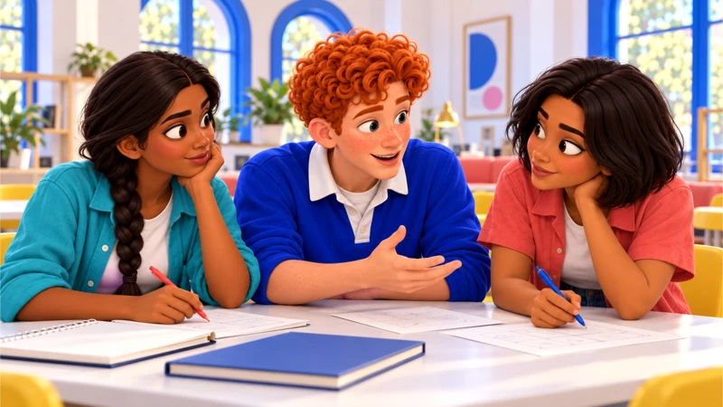
No, Pero Why?
Case 2 9
Make something someone can use
Make a short support conversation starter, with Dec’s permission.
Name the learning goal, two observations, one unknown and a question for the teacher. Keep private records out.
Writing, audio or a paper draft all work.
Notes:
Independent or paired drafting: 15 minutes. Use the workbook for a first draft and evidence reference. A spoken response can be dictated or transcribed. Respect individual support plans. Public posting is never required.
The response describes observations, requests a conversation and accurately limits the federal rule to IDEA evaluations.
Curriculum: grades 6–12, original fictional Common Room evidence. No personal disclosure or public posting required.
Primary sources:
IDEA, 34 CFR § 300.304: https://sites.ed.gov/idea/regs/b/d/300.304
Federal requirements for special-education evaluation procedures.
CAST, UDL Guidelines 3.0: https://udlguidelines.cast.org/
Design guidance for reducing barriers while keeping learning goals clear.
CAST UDL: https://udlguidelines.cast.org/
NAMLE principles: https://namle.org/resources/core-principles/

Slide 10
No, Pero Why?
Case 2 10
One response to test
We were practicing how circuits work. I could trace the route aloud, but lost my place in the written layout. Could we discuss how the task measures that goal and what support options are available? I can bring both examples.
Which part is supported? What would you revise?
Notes:
Show after students draft, or earlier as a model when support is needed. This is a possible response, not a script to copy. Have students mark a claim, supporting detail, limit and next step. Case 4 can support other recommendations.
Choice 1B gathers another observation while preserving the goal. Choice 2C makes a specific, permission-based request. A support conversation does not decide legal eligibility.
College extension: Compare assessment validity with UDL and the legal evaluation standard. Identify what facts would be needed before discussing a particular legal claim.
Curriculum: grades 6–12, original fictional Common Room evidence. No personal disclosure or public posting required.
Primary sources:
IDEA, 34 CFR § 300.304: https://sites.ed.gov/idea/regs/b/d/300.304
Federal requirements for special-education evaluation procedures.
CAST, UDL Guidelines 3.0: https://udlguidelines.cast.org/
Design guidance for reducing barriers while keeping learning goals clear.
CAST UDL: https://udlguidelines.cast.org/
NAMLE principles: https://namle.org/resources/core-principles/

Slide 11
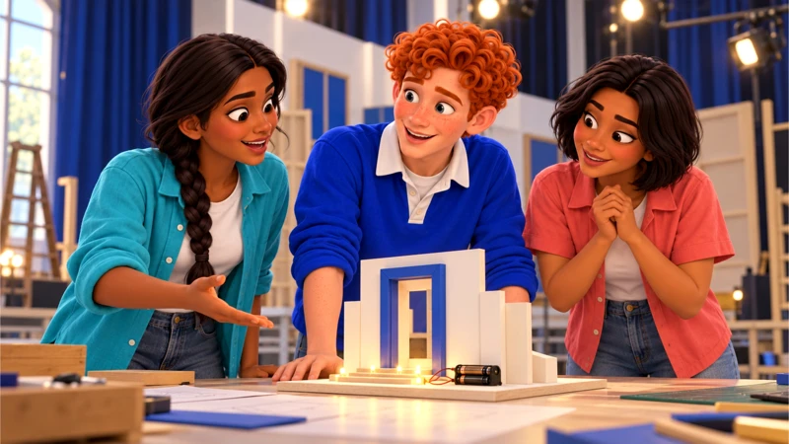
No, Pero Why?
Case 2 11
Where could this go next?
Find the school’s published route for asking about learning support. Write a question rather than submitting a classmate’s details.
A private question or draft counts. You choose how to take part.
Notes:
Use a mock or private route by default. Authentic activity is voluntary and educator-managed. No outside accounts, travel, interviews, petition signatures or political declarations required.
Ask a partner for one good-faith question, then revise.
Curriculum: grades 6–12, original fictional Common Room evidence. No personal disclosure or public posting required.
Primary sources:
IDEA, 34 CFR § 300.304: https://sites.ed.gov/idea/regs/b/d/300.304
Federal requirements for special-education evaluation procedures.
CAST, UDL Guidelines 3.0: https://udlguidelines.cast.org/
Design guidance for reducing barriers while keeping learning goals clear.
CAST UDL: https://udlguidelines.cast.org/
NAMLE principles: https://namle.org/resources/core-principles/

Slide 12
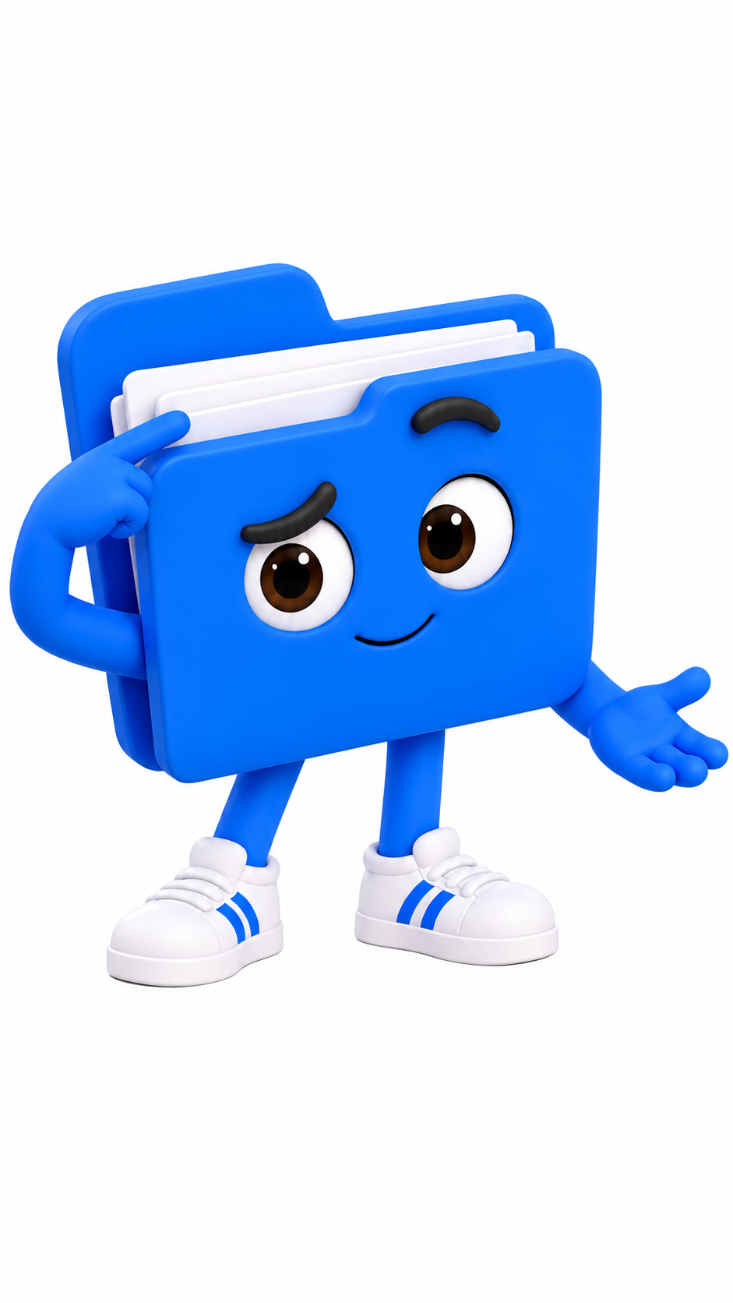
No, Pero Why?
Case 2 12
Your take, with something behind it
My claim is clear.
I can point to evidence.
I named a limit.
Someone knows the next step.
I can explain my revision.
Keep the question going.
Sources and teaching notes are in this deck.
Notes:
Assess evidence, reasoning, perspective/authority, communication and revision, each on the guide’s 1–3 scale if a score is needed. Do not assess political agreement or performance style.
Exit: explain one revision and what prompted it.
Research foundations: NCSS C3 Framework https://www.socialstudies.org/sites/default/files/c3/c3-framework-for-social-studies-rev0617.pdf
Digital Inquiry Group https://cor.inquirygroup.org/curriculum/collections/teaching-lateral-reading/
5 min: Revisit the goal — Compare two proposed practice changes and ask whether each still shows circuit reasoning.
12 min: Read the legal scope — Read evidence C and the federal source excerpt summary. Explain that IDEA’s varied-measures rule governs its evaluation process, not every classroom quiz.
8 min: Try the choices — Discuss the teacher messages. Pauta asks which claims are supported and which require another process.
15 min: Prepare the request — Draft a 60–100 word message in Dec’s voice with his permission. Include two observations, a question and no private records.
5 min: Check the next step — Name an appropriate school contact and a question to ask. Use a fictional school if preferred.
Curriculum: grades 6–12, original fictional Common Room evidence. No personal disclosure or public posting required.
Primary sources:
IDEA, 34 CFR § 300.304: https://sites.ed.gov/idea/regs/b/d/300.304
Federal requirements for special-education evaluation procedures.
CAST, UDL Guidelines 3.0: https://udlguidelines.cast.org/
Design guidance for reducing barriers while keeping learning goals clear.
CAST UDL: https://udlguidelines.cast.org/
NAMLE principles: https://namle.org/resources/core-principles/

Slide 13
No, Pero Why?
Case 2 13
The method behind the move
Issue, rule, application, conclusion
1 Issue
2 Rule
Are we checking circuit understanding, reading speed, or both?
Separate the task goal from IDEA rules for a formal evaluation.
3 Application
4 Conclusion
Compare Dec’s spoken explanation with his written attempt. Name what the mismatch leaves unresolved.
Propose a demonstration of the same goal and one question to ask next.
Notes:
IRAC, American Bar Association: https://www.americanbar.org/groups/law_students/resources/student-lawyer/student-essentials/legal-reasoning-its-all-about-irac/
IDEA evaluation rules: https://sites.ed.gov/idea/regs/b/d/300.304
These methods are classroom adaptations. Provide “I noticed __” and “Could we talk about __?” stems. Read legal vocabulary aloud. Use a large circuit diagram or a paper sketch rather than timed reading.
Grades 9–12: Distinguish classroom practice, IDEA evaluation, eligibility and an IEP. Explain why one observation may justify a question but does not settle any of those steps.
Curriculum: grades 6–12, original fictional Common Room evidence. No personal disclosure or public posting required.
Primary sources:
IDEA, 34 CFR § 300.304: https://sites.ed.gov/idea/regs/b/d/300.304
Federal requirements for special-education evaluation procedures.
CAST, UDL Guidelines 3.0: https://udlguidelines.cast.org/
Design guidance for reducing barriers while keeping learning goals clear.
CAST UDL: https://udlguidelines.cast.org/
NAMLE principles: https://namle.org/resources/core-principles/

Slide 14
No, Pero Why?
Case 2 14
The workshop can go deeper
Grades 6–8
Provide “I noticed __” and “Could we talk about __?” stems. Read legal vocabulary aloud. Use a large circuit diagram or a paper sketch rather than timed reading.
Grades 9–12
Distinguish classroom practice, IDEA evaluation, eligibility and an IEP. Explain why one observation may justify a question but does not settle any of those steps.
Course options
Pre-AP close analysis. AP argument and rhetoric. MYP purposeful texts. DP nonliterary textual analysis. Honors independent corroboration.
Notes:
Teacher reference. Select the actual grade/year descriptor in the curriculum crosswalk. These are independently designed practice tasks, not official assessment components or full course certification. Each route requires submitted writing and reasoning. Discussion targets require an actual exchange.
Curriculum: grades 6–12, original fictional Common Room evidence. No personal disclosure or public posting required.
Primary sources:
IDEA, 34 CFR § 300.304: https://sites.ed.gov/idea/regs/b/d/300.304
Federal requirements for special-education evaluation procedures.
CAST, UDL Guidelines 3.0: https://udlguidelines.cast.org/
Design guidance for reducing barriers while keeping learning goals clear.
CAST UDL: https://udlguidelines.cast.org/
NAMLE principles: https://namle.org/resources/core-principles/

