Slide 1
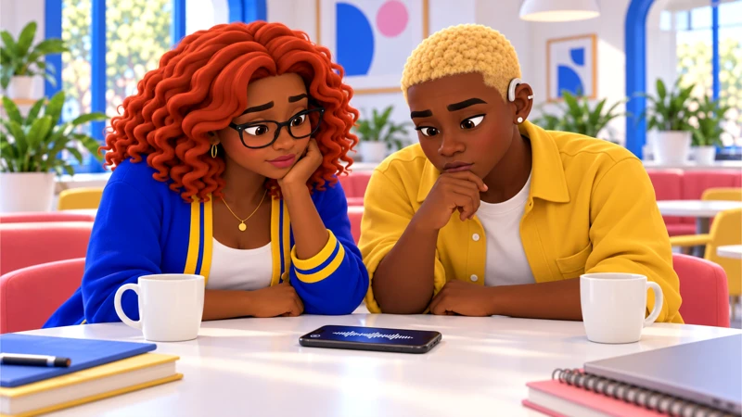
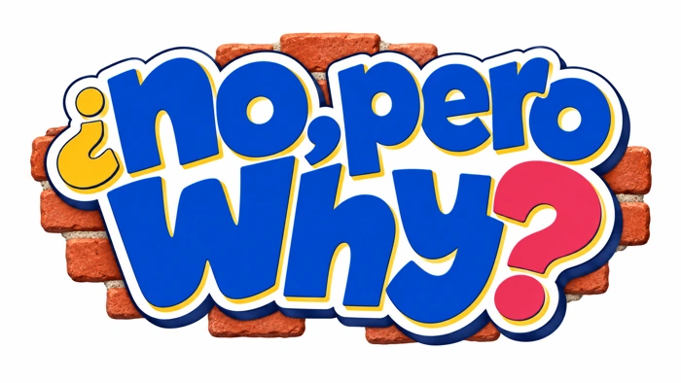
No, Pero Why?
Case 3 1
The apology is not the repair
Casebook 1
What makes a correction more useful than “sorry”?
Your questions. The evidence. A response you can explain.
Notes:
Workshops 5–6. Each session is 45 minutes. Correct an unsupported public claim and propose a repair with a named owner.
Prepare the case workbook, evidence A–C, and response supports. Default to text and original character scenes. Film and social clips are optional and require preview.
Workshop 1 timing: 5 min Read the caption, 10 min Compare the record, 10 min Hear the response, 15 min Examine the draft, 5 min Exit
Curriculum: grades 6–12, original fictional Common Room evidence. No personal disclosure or public posting required.
Primary sources:
PRSA, Code of Ethics: https://www.prsa.org/professional-development/prsa-resources/ethics
Professional guidance on honesty, accuracy and correcting erroneous communication.
SPJ, Code of Ethics: https://www.spj.org/spj-code-of-ethics/
Verification, minimizing harm and accountability.
Critical Media Project, Zootopia scene: https://criticalmediaproject.org/zootopia-press-conference-scene/
The embedded press-conference excerpt and its film context.
CAST UDL: https://udlguidelines.cast.org/
NAMLE principles: https://namle.org/resources/core-principles/

Slide 2
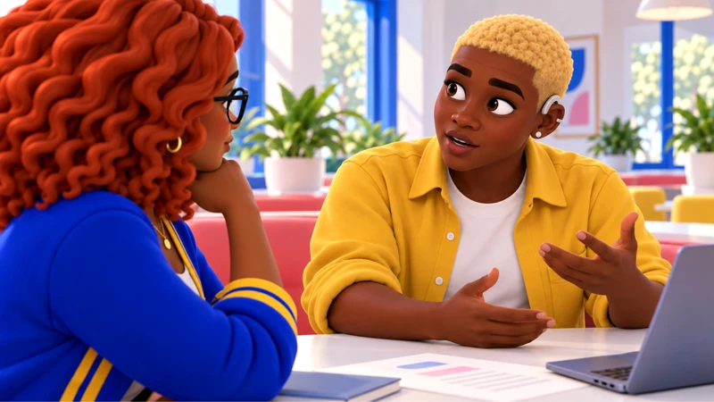
No, Pero Why?
Case 3 2
Here is what happened
The recap blamed younger visitors for the delay. The event log points to the projector.
Anika helped set up. Now the caption makes her group sound like the problem. Gia wants to respond, but her first draft only explains her intentions.
Notes:
Read the full premise from the workbook. Caio, 24, has edited a short recap of Friday’s screening. Gia writes a caption saying younger visitors caused the slow start. It sounds plausible because a few arrived late. Then Jordy checks the event log: the projector was down for twenty minutes. Anika messages the group: “We were helping you set up. Why are we the problem in this post?” Gia wants to take responsibility, but her first draft is mostly about how upset she feels. You are helping make the correction useful to the people it affected.
Warm-up: What do you know, and what are you assuming? Let students write before discussing. Do not require personal stories.
Curriculum: grades 6–12, original fictional Common Room evidence. No personal disclosure or public posting required.
Primary sources:
PRSA, Code of Ethics: https://www.prsa.org/professional-development/prsa-resources/ethics
Professional guidance on honesty, accuracy and correcting erroneous communication.
SPJ, Code of Ethics: https://www.spj.org/spj-code-of-ethics/
Verification, minimizing harm and accountability.
Critical Media Project, Zootopia scene: https://criticalmediaproject.org/zootopia-press-conference-scene/
The embedded press-conference excerpt and its film context.
CAST UDL: https://udlguidelines.cast.org/
NAMLE principles: https://namle.org/resources/core-principles/

Slide 3
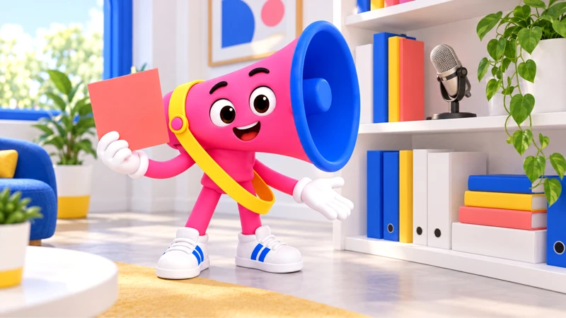
No, Pero Why?
Case 3 3
Voz has a question
What makes a correction more useful than “sorry”?
What would you need to check before deciding?
Notes:
Learning target: Correct an unsupported public claim and propose a repair with a named owner.
Use a four-line template: “We said __. The record shows __. We changed __. Next time __ will __.” Let students annotate a provided draft.
Ask students to turn an assumption into a checkable question. The companion prompts inquiry; it does not provide the correct position.
Curriculum: grades 6–12, original fictional Common Room evidence. No personal disclosure or public posting required.
Primary sources:
PRSA, Code of Ethics: https://www.prsa.org/professional-development/prsa-resources/ethics
Professional guidance on honesty, accuracy and correcting erroneous communication.
SPJ, Code of Ethics: https://www.spj.org/spj-code-of-ethics/
Verification, minimizing harm and accountability.
Critical Media Project, Zootopia scene: https://criticalmediaproject.org/zootopia-press-conference-scene/
The embedded press-conference excerpt and its film context.
CAST UDL: https://udlguidelines.cast.org/
NAMLE principles: https://namle.org/resources/core-principles/

Slide 4
No, Pero Why?
Case 3 4
Two records, two different jobs
A. The published caption
B. The event log
“Great night, once the younger crowd finally got organized.” The caption names no evidence for the delay and gives viewers a group to blame.
5:40 p.m. projector failure reported. 6:00 p.m. attendees seated. 6:20 p.m. replacement projector connected. Anika and Dec helped carry chairs before doors opened.
What can this establish?
What can this establish?
Notes:
Original fictional case records for classroom analysis. The published caption: The statement itself is evidence of what the crew communicated, not proof of the cause.
The event log: It challenges the caption’s explanation. It does not describe every attendee’s experience.
Students mark one exact detail, then connect it to a claim. Do not equate the fact that a statement was published with proof that it is accurate.
Curriculum: grades 6–12, original fictional Common Room evidence. No personal disclosure or public posting required.
Primary sources:
PRSA, Code of Ethics: https://www.prsa.org/professional-development/prsa-resources/ethics
Professional guidance on honesty, accuracy and correcting erroneous communication.
SPJ, Code of Ethics: https://www.spj.org/spj-code-of-ethics/
Verification, minimizing harm and accountability.
Critical Media Project, Zootopia scene: https://criticalmediaproject.org/zootopia-press-conference-scene/
The embedded press-conference excerpt and its film context.
CAST UDL: https://udlguidelines.cast.org/
NAMLE principles: https://namle.org/resources/core-principles/

Slide 5
No, Pero Why?
Case 3 5
One more piece of the picture
C. Gia’s first correction
“Sorry if this came across wrong. We love our younger neighbors and would never want anyone to feel excluded.”
What this leaves open
The draft describes intent without correcting the cause or naming a practical change.
Notes:
Discuss scope before a conclusion. Feeling sorry can be sincere and still leave the record wrong. The person blamed does not owe public reassurance to the person who wrote the claim.
The student identifies the projector delay and explains why a general statement of good intent fails to correct the cause.
Case 2: the federal evaluation rule is a paraphrase, not a verbatim quotation. IDEA evaluates disability and educational needs. It does not prescribe every classroom quiz.
Curriculum: grades 6–12, original fictional Common Room evidence. No personal disclosure or public posting required.
Primary sources:
PRSA, Code of Ethics: https://www.prsa.org/professional-development/prsa-resources/ethics
Professional guidance on honesty, accuracy and correcting erroneous communication.
SPJ, Code of Ethics: https://www.spj.org/spj-code-of-ethics/
Verification, minimizing harm and accountability.
Critical Media Project, Zootopia scene: https://criticalmediaproject.org/zootopia-press-conference-scene/
The embedded press-conference excerpt and its film context.
CAST UDL: https://udlguidelines.cast.org/
NAMLE principles: https://namle.org/resources/core-principles/

Slide 6
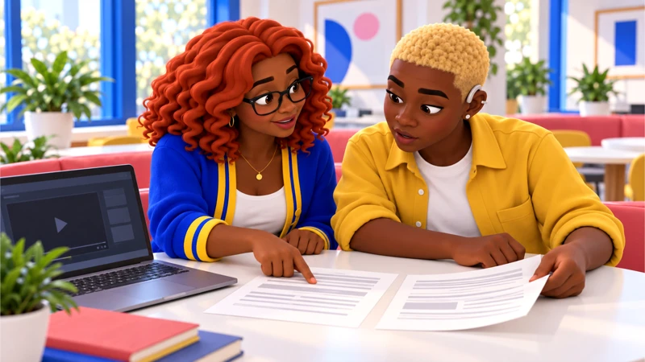
No, Pero Why?
Case 3 6
What changed in your first take?
The evidence supports…
We still need to know…
I changed my view because…
Notes:
Close session 5. Use a private exit response. The student identifies the projector delay and explains why a general statement of good intent fails to correct the cause.
For more depth: Analyze how the correction reaches people who saw the original. Separate a factual correction from an apology and a repair. Identify a measurable follow-up.
At the next session, recall the evidence before discussing decisions.
Curriculum: grades 6–12, original fictional Common Room evidence. No personal disclosure or public posting required.
Primary sources:
PRSA, Code of Ethics: https://www.prsa.org/professional-development/prsa-resources/ethics
Professional guidance on honesty, accuracy and correcting erroneous communication.
SPJ, Code of Ethics: https://www.spj.org/spj-code-of-ethics/
Verification, minimizing harm and accountability.
Critical Media Project, Zootopia scene: https://criticalmediaproject.org/zootopia-press-conference-scene/
The embedded press-conference excerpt and its film context.
CAST UDL: https://udlguidelines.cast.org/
NAMLE principles: https://namle.org/resources/core-principles/

Slide 7
No, Pero Why?
Case 3 7
What goes first in the correction?
A. Explain how awful Gia feels.
B. Name the inaccurate claim and what the event log shows.
C. Delete everything and say nothing.
Notes:
Session 6. Students choose individually, justify, then compare. A student may revise.
A: Her feelings can be real, but they do not correct the record. Anika still needs the false blame removed.
B: Gia owns the caption and identifies the projector delay. The correction gives people new, checkable information.
C: The misleading claim may keep circulating in screenshots. Caio asks how people who saw it will learn what was wrong.
Curriculum: grades 6–12, original fictional Common Room evidence. No personal disclosure or public posting required.
Primary sources:
PRSA, Code of Ethics: https://www.prsa.org/professional-development/prsa-resources/ethics
Professional guidance on honesty, accuracy and correcting erroneous communication.
SPJ, Code of Ethics: https://www.spj.org/spj-code-of-ethics/
Verification, minimizing harm and accountability.
Critical Media Project, Zootopia scene: https://criticalmediaproject.org/zootopia-press-conference-scene/
The embedded press-conference excerpt and its film context.
CAST UDL: https://udlguidelines.cast.org/
NAMLE principles: https://namle.org/resources/core-principles/

Slide 8
No, Pero Why?
Case 3 8
Which repair can the crew actually carry out?
A. Promise nobody will ever make a mistake again.
B. Ask Anika to post that Gia is a good person.
C. Correct the post, contact those blamed, and check event claims against the log before publishing.
Notes:
Use evidence, likely effects and institutional authority to evaluate each response.
A: That promise is impossible to verify. Jordy wants a process they can actually follow.
B: That puts the work on the person blamed. Anika can choose whether to respond; she does not owe the crew reassurance.
C: The response names an action, an owner and a repeatable check. Caio still asks the affected people what the draft misses.
Choice 1B corrects the record. Choice 2C combines correction, outreach and a repeatable check. A different repair may work if it addresses the harm and is feasible.
Curriculum: grades 6–12, original fictional Common Room evidence. No personal disclosure or public posting required.
Primary sources:
PRSA, Code of Ethics: https://www.prsa.org/professional-development/prsa-resources/ethics
Professional guidance on honesty, accuracy and correcting erroneous communication.
SPJ, Code of Ethics: https://www.spj.org/spj-code-of-ethics/
Verification, minimizing harm and accountability.
Critical Media Project, Zootopia scene: https://criticalmediaproject.org/zootopia-press-conference-scene/
The embedded press-conference excerpt and its film context.
CAST UDL: https://udlguidelines.cast.org/
NAMLE principles: https://namle.org/resources/core-principles/

Slide 9
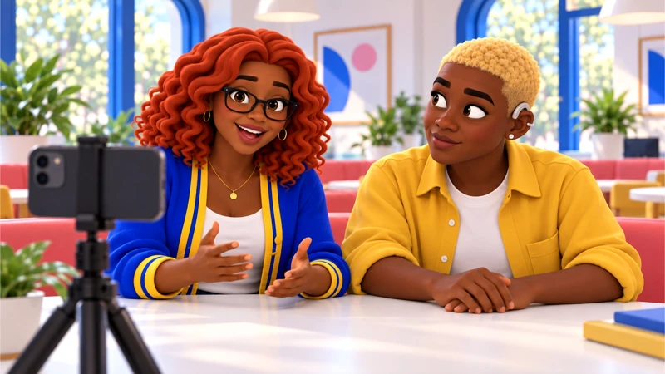
No, Pero Why?
Case 3 9
Make something someone can use
Write a correction and a repair plan that are bigger than “sorry.”
Own the inaccurate claim, replace it with supported information and name who will do what next.
Writing, audio or a paper draft all work.
Notes:
Independent or paired drafting: 15 minutes. Use the workbook for a first draft and evidence reference. A spoken response can be dictated or transcribed. Respect individual support plans. Public posting is never required.
The correction owns the inaccurate claim, supplies a supported account and proposes a check the crew can actually perform.
Curriculum: grades 6–12, original fictional Common Room evidence. No personal disclosure or public posting required.
Primary sources:
PRSA, Code of Ethics: https://www.prsa.org/professional-development/prsa-resources/ethics
Professional guidance on honesty, accuracy and correcting erroneous communication.
SPJ, Code of Ethics: https://www.spj.org/spj-code-of-ethics/
Verification, minimizing harm and accountability.
Critical Media Project, Zootopia scene: https://criticalmediaproject.org/zootopia-press-conference-scene/
The embedded press-conference excerpt and its film context.
CAST UDL: https://udlguidelines.cast.org/
NAMLE principles: https://namle.org/resources/core-principles/

Slide 10
No, Pero Why?
Case 3 10
One response to test
Our recap wrongly blamed younger attendees for the late start. The event log shows a projector failure delayed the screening. We have corrected the original caption and contacted the people it blamed. Gia and Jordy will check factual claims against the event record before the next recap.
Which part is supported? What would you revise?
Notes:
Show after students draft, or earlier as a model when support is needed. This is a possible response, not a script to copy. Have students mark a claim, supporting detail, limit and next step. Case 4 can support other recommendations.
Choice 1B corrects the record. Choice 2C combines correction, outreach and a repeatable check. A different repair may work if it addresses the harm and is feasible.
College extension: Use PRSA and SPJ duties to compare communication goals. Explain tensions between reputation protection, accountability and minimizing further harm.
Curriculum: grades 6–12, original fictional Common Room evidence. No personal disclosure or public posting required.
Primary sources:
PRSA, Code of Ethics: https://www.prsa.org/professional-development/prsa-resources/ethics
Professional guidance on honesty, accuracy and correcting erroneous communication.
SPJ, Code of Ethics: https://www.spj.org/spj-code-of-ethics/
Verification, minimizing harm and accountability.
Critical Media Project, Zootopia scene: https://criticalmediaproject.org/zootopia-press-conference-scene/
The embedded press-conference excerpt and its film context.
CAST UDL: https://udlguidelines.cast.org/
NAMLE principles: https://namle.org/resources/core-principles/

Slide 11
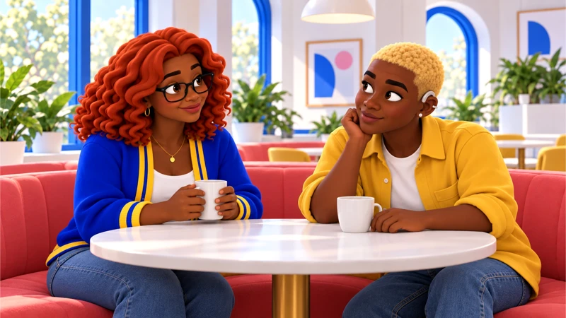
No, Pero Why?
Case 3 11
Where could this go next?
Create a corrections checklist for a classroom newsletter or student club. Ask its editor how factual claims get checked.
A private question or draft counts. You choose how to take part.
Notes:
Use a mock or private route by default. Authentic activity is voluntary and educator-managed. No outside accounts, travel, interviews, petition signatures or political declarations required.
Ask a partner for one good-faith question, then revise.
Curriculum: grades 6–12, original fictional Common Room evidence. No personal disclosure or public posting required.
Primary sources:
PRSA, Code of Ethics: https://www.prsa.org/professional-development/prsa-resources/ethics
Professional guidance on honesty, accuracy and correcting erroneous communication.
SPJ, Code of Ethics: https://www.spj.org/spj-code-of-ethics/
Verification, minimizing harm and accountability.
Critical Media Project, Zootopia scene: https://criticalmediaproject.org/zootopia-press-conference-scene/
The embedded press-conference excerpt and its film context.
CAST UDL: https://udlguidelines.cast.org/
NAMLE principles: https://namle.org/resources/core-principles/

Slide 12
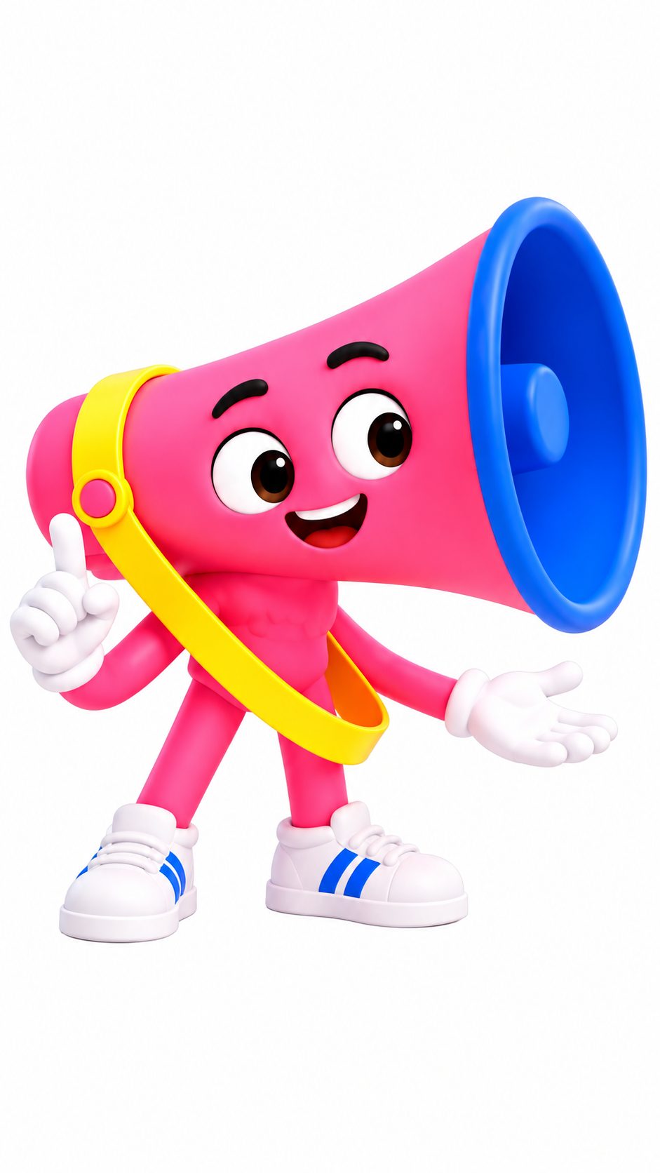
No, Pero Why?
Case 3 12
Your take, with something behind it
My claim is clear.
I can point to evidence.
I named a limit.
Someone knows the next step.
I can explain my revision.
Keep the question going.
Sources and teaching notes are in this deck.
Notes:
Assess evidence, reasoning, perspective/authority, communication and revision, each on the guide’s 1–3 scale if a score is needed. Do not assess political agreement or performance style.
Exit: explain one revision and what prompted it.
Research foundations: NCSS C3 Framework https://www.socialstudies.org/sites/default/files/c3/c3-framework-for-social-studies-rev0617.pdf
Digital Inquiry Group https://cor.inquirygroup.org/curriculum/collections/teaching-lateral-reading/
5 min: Recall the timeline — Ask what the log proves and what it cannot prove about every attendee’s experience.
10 min: Consider the choices — Compare deletion, a correction and asking Anika for reassurance. Discuss who does the work in each response.
15 min: Write the repair — Draft a 70–100 word correction. Add one action, its owner and when the crew will check whether it happened.
10 min: Peer editorial desk — Partners check factual accuracy, reach and responsibility using the workbook. Revision is part of the assessment.
5 min: Exit — Complete: “Our next recap will change because __.”
Curriculum: grades 6–12, original fictional Common Room evidence. No personal disclosure or public posting required.
Primary sources:
PRSA, Code of Ethics: https://www.prsa.org/professional-development/prsa-resources/ethics
Professional guidance on honesty, accuracy and correcting erroneous communication.
SPJ, Code of Ethics: https://www.spj.org/spj-code-of-ethics/
Verification, minimizing harm and accountability.
Critical Media Project, Zootopia scene: https://criticalmediaproject.org/zootopia-press-conference-scene/
The embedded press-conference excerpt and its film context.
CAST UDL: https://udlguidelines.cast.org/
NAMLE principles: https://namle.org/resources/core-principles/

Slide 13
No, Pero Why?
Case 3 13
The method behind the move
Research, planning, implementation, evaluation
1 Research
2 Planning
Put the recap beside the event log. Ask Anika what the group label changes for her.
Name who needs the correction and what they should understand afterward.
3 Implementation
4 Evaluation
Replace the inaccurate claim. State the repair and who will carry it out.
Ask readers what they now believe caused the delay. Views alone do not show understanding.
Notes:
RPIE, Universal Accreditation Board: https://www.prsa.org/docs/default-source/accreditation-site/apr-study-guide.pdf?sfvrsn=3023e23c_2
Sociological perspective, OpenStax: https://openstax.org/books/introduction-sociology-3e/pages/1-1-what-is-sociology
These methods are classroom adaptations. Use a four-line template: “We said __. The record shows __. We changed __. Next time __ will __.” Let students annotate a provided draft.
Grades 9–12: Analyze how the correction reaches people who saw the original. Separate a factual correction from an apology and a repair. Identify a measurable follow-up.
Curriculum: grades 6–12, original fictional Common Room evidence. No personal disclosure or public posting required.
Primary sources:
PRSA, Code of Ethics: https://www.prsa.org/professional-development/prsa-resources/ethics
Professional guidance on honesty, accuracy and correcting erroneous communication.
SPJ, Code of Ethics: https://www.spj.org/spj-code-of-ethics/
Verification, minimizing harm and accountability.
Critical Media Project, Zootopia scene: https://criticalmediaproject.org/zootopia-press-conference-scene/
The embedded press-conference excerpt and its film context.
CAST UDL: https://udlguidelines.cast.org/
NAMLE principles: https://namle.org/resources/core-principles/

Slide 14
No, Pero Why?
Case 3 14
The workshop can go deeper
Grades 6–8
Use a four-line template: “We said __. The record shows __. We changed __. Next time __ will __.” Let students annotate a provided draft.
Grades 9–12
Analyze how the correction reaches people who saw the original. Separate a factual correction from an apology and a repair. Identify a measurable follow-up.
Course options
Pre-AP close analysis. AP argument and rhetoric. MYP purposeful texts. DP nonliterary textual analysis. Honors independent corroboration.
Notes:
Teacher reference. Select the actual grade/year descriptor in the curriculum crosswalk. These are independently designed practice tasks, not official assessment components or full course certification. Each route requires submitted writing and reasoning. Discussion targets require an actual exchange.
Curriculum: grades 6–12, original fictional Common Room evidence. No personal disclosure or public posting required.
Primary sources:
PRSA, Code of Ethics: https://www.prsa.org/professional-development/prsa-resources/ethics
Professional guidance on honesty, accuracy and correcting erroneous communication.
SPJ, Code of Ethics: https://www.spj.org/spj-code-of-ethics/
Verification, minimizing harm and accountability.
Critical Media Project, Zootopia scene: https://criticalmediaproject.org/zootopia-press-conference-scene/
The embedded press-conference excerpt and its film context.
CAST UDL: https://udlguidelines.cast.org/
NAMLE principles: https://namle.org/resources/core-principles/

