Slide 1

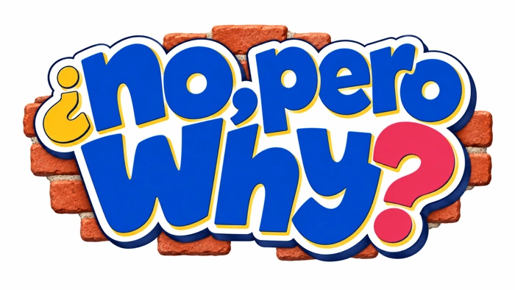
No, Pero Why?
Case 4 1
Whose room is it, anyway?
Casebook 1
Who gets a say when a shared space changes?
Your questions. The evidence. A response you can explain.
Notes:
Workshops 7–8. Each session is 45 minutes. Compare a proposal’s budget and access effects, then recommend a next step to the actual decision-maker.
Prepare the case workbook, evidence A–C, and response supports. Default to text and original character scenes. Film and social clips are optional and require preview.
Workshop 1 timing: 5 min Name the decision, 10 min Hear the room, 15 min Work the figures, 10 min Ask better questions, 5 min Exit
Curriculum: grades 6–12, original fictional Common Room evidence. No personal disclosure or public posting required.
Primary sources:
Carol Bacchi, WPR: https://carolbacchi.com/about/
A policy-analysis approach that examines the problem represented in a proposed solution.
NYC, About community boards: https://www.nyc.gov/site/brooklyncb13/about/about-community-boards.page
A real local example of advisory authority and public participation. Check your own board’s procedures.
Design Council, Double Diamond: https://www.designcouncil.org.uk/resources/the-double-diamond/
A framework for exploring a problem and testing responses.
CAST UDL: https://udlguidelines.cast.org/
NAMLE principles: https://namle.org/resources/core-principles/

Slide 2

No, Pero Why?
Case 4 2
Here is what happened
The room needs funding. A new rental schedule could change who gets to use it.
Mari knows evening staff need to be paid. Sami needs a place after her shift. The nonprofit board has options on its agenda, but has not voted.
Notes:
Read the full premise from the workbook. The Common Room is run by a small neighborhood nonprofit alongside the bookshop. Its board is considering two paid evening rentals a week to help cover staffing. Nothing has passed yet. Mari, 19, works the counter. She knows “just keep it free” does not pay the evening staff. Sami, 23, needs an accessible place to meet clients after her print-shop shift. Mateo wants to start a petition immediately. The crew agrees the room matters; they do not agree on the best schedule. You are helping them make a specific, informed request before the board meeting.
Warm-up: What do you know, and what are you assuming? Let students write before discussing. Do not require personal stories.
Curriculum: grades 6–12, original fictional Common Room evidence. No personal disclosure or public posting required.
Primary sources:
Carol Bacchi, WPR: https://carolbacchi.com/about/
A policy-analysis approach that examines the problem represented in a proposed solution.
NYC, About community boards: https://www.nyc.gov/site/brooklyncb13/about/about-community-boards.page
A real local example of advisory authority and public participation. Check your own board’s procedures.
Design Council, Double Diamond: https://www.designcouncil.org.uk/resources/the-double-diamond/
A framework for exploring a problem and testing responses.
CAST UDL: https://udlguidelines.cast.org/
NAMLE principles: https://namle.org/resources/core-principles/

Slide 3
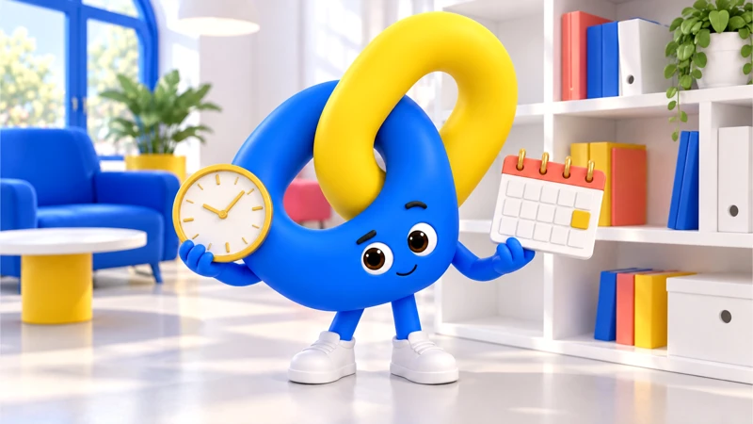
No, Pero Why?
Case 4 3
Nexo has a question
Who gets a say when a shared space changes?
What would you need to check before deciding?
Notes:
Learning target: Compare a proposal’s budget and access effects, then recommend a next step to the actual decision-maker.
Use a calculator, a completed $600 minus $400 example and a people-map organizer. Read one option at a time. Offer a written comment rather than public speaking.
Ask students to turn an assumption into a checkable question. The companion prompts inquiry; it does not provide the correct position.
Curriculum: grades 6–12, original fictional Common Room evidence. No personal disclosure or public posting required.
Primary sources:
Carol Bacchi, WPR: https://carolbacchi.com/about/
A policy-analysis approach that examines the problem represented in a proposed solution.
NYC, About community boards: https://www.nyc.gov/site/brooklyncb13/about/about-community-boards.page
A real local example of advisory authority and public participation. Check your own board’s procedures.
Design Council, Double Diamond: https://www.designcouncil.org.uk/resources/the-double-diamond/
A framework for exploring a problem and testing responses.
CAST UDL: https://udlguidelines.cast.org/
NAMLE principles: https://namle.org/resources/core-principles/

Slide 4
No, Pero Why?
Case 4 4
Two records, two different jobs
A. The proposal
B. The budget note
Option A keeps the current free evenings with a funding gap. Option B replaces Tuesday and Thursday evenings with paid rentals. Option C pilots one rental evening for six weeks while seeking additional funding. The board will discuss the options; no vote has happened.
Evening staffing and utilities: $600. Current grants and donations: $400. Each paid rental is projected to add $120 after its extra costs. Two bookings would add $240; one would add $120. Demand is uncertain.
What can this establish?
What can this establish?
Notes:
Original fictional case records for classroom analysis. The proposal: An agenda is not an adopted decision. A pilot is still a change with consequences.
The budget note: These are invented estimates for practice. Two bookings could cover the $200 gap if the projection holds; one alone would leave $80.
Students mark one exact detail, then connect it to a claim. Do not equate the fact that a statement was published with proof that it is accurate.
Curriculum: grades 6–12, original fictional Common Room evidence. No personal disclosure or public posting required.
Primary sources:
Carol Bacchi, WPR: https://carolbacchi.com/about/
A policy-analysis approach that examines the problem represented in a proposed solution.
NYC, About community boards: https://www.nyc.gov/site/brooklyncb13/about/about-community-boards.page
A real local example of advisory authority and public participation. Check your own board’s procedures.
Design Council, Double Diamond: https://www.designcouncil.org.uk/resources/the-double-diamond/
A framework for exploring a problem and testing responses.
CAST UDL: https://udlguidelines.cast.org/
NAMLE principles: https://namle.org/resources/core-principles/

Slide 5
No, Pero Why?
Case 4 5
One more piece of the picture
C. The missing voices
Sami works afternoons. Dec rehearses on Thursdays. Mari closes the shop. A nearby resident worries about late noise. The proposed meeting time overlaps with several shifts.
What this leaves open
Four voices do not represent everyone. Ask who is missing and offer a way to contribute outside the meeting.
Notes:
Discuss scope before a conclusion. An agenda is not a final vote. A revenue estimate is not guaranteed income. The nonprofit board in the story is not a government community board.
The student calculates $200 and $80 correctly, describes projections conditionally and names the nonprofit board as the story’s decision-maker.
Case 2: the federal evaluation rule is a paraphrase, not a verbatim quotation. IDEA evaluates disability and educational needs. It does not prescribe every classroom quiz.
Curriculum: grades 6–12, original fictional Common Room evidence. No personal disclosure or public posting required.
Primary sources:
Carol Bacchi, WPR: https://carolbacchi.com/about/
A policy-analysis approach that examines the problem represented in a proposed solution.
NYC, About community boards: https://www.nyc.gov/site/brooklyncb13/about/about-community-boards.page
A real local example of advisory authority and public participation. Check your own board’s procedures.
Design Council, Double Diamond: https://www.designcouncil.org.uk/resources/the-double-diamond/
A framework for exploring a problem and testing responses.
CAST UDL: https://udlguidelines.cast.org/
NAMLE principles: https://namle.org/resources/core-principles/

Slide 6

No, Pero Why?
Case 4 6
What changed in your first take?
The evidence supports…
We still need to know…
I changed my view because…
Notes:
Close session 7. Use a private exit response. The student calculates $200 and $80 correctly, describes projections conditionally and names the nonprofit board as the story’s decision-maker.
For more depth: Test a zero-booking scenario and explain what the pilot would measure. Compare who attends with who is affected. Suggest an accessible feedback route.
At the next session, recall the evidence before discussing decisions.
Curriculum: grades 6–12, original fictional Common Room evidence. No personal disclosure or public posting required.
Primary sources:
Carol Bacchi, WPR: https://carolbacchi.com/about/
A policy-analysis approach that examines the problem represented in a proposed solution.
NYC, About community boards: https://www.nyc.gov/site/brooklyncb13/about/about-community-boards.page
A real local example of advisory authority and public participation. Check your own board’s procedures.
Design Council, Double Diamond: https://www.designcouncil.org.uk/resources/the-double-diamond/
A framework for exploring a problem and testing responses.
CAST UDL: https://udlguidelines.cast.org/
NAMLE principles: https://namle.org/resources/core-principles/

Slide 7
No, Pero Why?
Case 4 7
What does the crew ask for first?
A. Say the board has already sold the room out.
B. Request the budget assumptions, who uses each evening, and a way to comment outside the meeting.
C. Support whichever option has the highest projected revenue.
Notes:
Session 8. Students choose individually, justify, then compare. A student may revise.
A: That treats a proposal as final and invents a motive. Mari asks you to make the concern specific enough to answer.
B: Sami helps draft questions about timing and access. The board can answer a concrete request without being asked to guess what the crew needs.
C: Revenue matters, but the projection does not measure who loses access. Nexo asks you to put both on the page.
Curriculum: grades 6–12, original fictional Common Room evidence. No personal disclosure or public posting required.
Primary sources:
Carol Bacchi, WPR: https://carolbacchi.com/about/
A policy-analysis approach that examines the problem represented in a proposed solution.
NYC, About community boards: https://www.nyc.gov/site/brooklyncb13/about/about-community-boards.page
A real local example of advisory authority and public participation. Check your own board’s procedures.
Design Council, Double Diamond: https://www.designcouncil.org.uk/resources/the-double-diamond/
A framework for exploring a problem and testing responses.
CAST UDL: https://udlguidelines.cast.org/
NAMLE principles: https://namle.org/resources/core-principles/

Slide 8
No, Pero Why?
Case 4 8
Which recommendation can you explain?
A. Keep it free, with no plan for the $200 gap.
B. Approve two paid nights because the forecast guarantees the money.
C. Propose a six-week pilot with an access check and a plan to close the remaining gap.
Notes:
Use evidence, likely effects and institutional authority to evaluate each response.
A: That states a preference without addressing the constraint. Add a credible funding or staffing question before calling it a complete recommendation.
B: A projection is conditional. Mari points out that empty bookings would change the result.
C: You acknowledge the $80 projected gap, ask who will track it, and request a review with evening users. This is a defensible proposal, not the only possible answer.
Choice 1B gathers decision-relevant information. Choice 2C offers a conditional pilot, but other recommendations can earn full credit when they address the gap, access and uncertainty.
Curriculum: grades 6–12, original fictional Common Room evidence. No personal disclosure or public posting required.
Primary sources:
Carol Bacchi, WPR: https://carolbacchi.com/about/
A policy-analysis approach that examines the problem represented in a proposed solution.
NYC, About community boards: https://www.nyc.gov/site/brooklyncb13/about/about-community-boards.page
A real local example of advisory authority and public participation. Check your own board’s procedures.
Design Council, Double Diamond: https://www.designcouncil.org.uk/resources/the-double-diamond/
A framework for exploring a problem and testing responses.
CAST UDL: https://udlguidelines.cast.org/
NAMLE principles: https://namle.org/resources/core-principles/

Slide 9

No, Pero Why?
Case 4 9
Make something someone can use
Prepare a 90-second comment for the nonprofit board.
Name the proposal, explain one effect, use one figure accurately and ask for a decision or follow-up the board can make.
Writing, audio or a paper draft all work.
Notes:
Independent or paired drafting: 15 minutes. Use the workbook for a first draft and evidence reference. A spoken response can be dictated or transcribed. Respect individual support plans. Public posting is never required.
The recommendation addresses both budget and access, names an assumption and requests something within the board’s authority.
Curriculum: grades 6–12, original fictional Common Room evidence. No personal disclosure or public posting required.
Primary sources:
Carol Bacchi, WPR: https://carolbacchi.com/about/
A policy-analysis approach that examines the problem represented in a proposed solution.
NYC, About community boards: https://www.nyc.gov/site/brooklyncb13/about/about-community-boards.page
A real local example of advisory authority and public participation. Check your own board’s procedures.
Design Council, Double Diamond: https://www.designcouncil.org.uk/resources/the-double-diamond/
A framework for exploring a problem and testing responses.
CAST UDL: https://udlguidelines.cast.org/
NAMLE principles: https://namle.org/resources/core-principles/

Slide 10
No, Pero Why?
Case 4 10
One response to test
I use the room after work. Removing both free evenings would leave me with fewer accessible meeting options. A one-night pilot would still leave a projected $80 weekly gap, so I’m asking for a funding plan, input from evening users and a review after six weeks before a longer-term change.
Which part is supported? What would you revise?
Notes:
Show after students draft, or earlier as a model when support is needed. This is a possible response, not a script to copy. Have students mark a claim, supporting detail, limit and next step. Case 4 can support other recommendations.
Choice 1B gathers decision-relevant information. Choice 2C offers a conditional pilot, but other recommendations can earn full credit when they address the gap, access and uncertainty.
College extension: Apply Bacchi’s WPR questions to how “the funding problem” is framed. Compare nonprofit governance with local public-board authority without treating them as interchangeable.
Curriculum: grades 6–12, original fictional Common Room evidence. No personal disclosure or public posting required.
Primary sources:
Carol Bacchi, WPR: https://carolbacchi.com/about/
A policy-analysis approach that examines the problem represented in a proposed solution.
NYC, About community boards: https://www.nyc.gov/site/brooklyncb13/about/about-community-boards.page
A real local example of advisory authority and public participation. Check your own board’s procedures.
Design Council, Double Diamond: https://www.designcouncil.org.uk/resources/the-double-diamond/
A framework for exploring a problem and testing responses.
CAST UDL: https://udlguidelines.cast.org/
NAMLE principles: https://namle.org/resources/core-principles/

Slide 11

No, Pero Why?
Case 4 11
Where could this go next?
Find a school committee, library meeting or local public agenda with a trusted adult. Identify the authority, process and a question before deciding whether to participate.
A private question or draft counts. You choose how to take part.
Notes:
Use a mock or private route by default. Authentic activity is voluntary and educator-managed. No outside accounts, travel, interviews, petition signatures or political declarations required.
Ask a partner for one good-faith question, then revise.
Curriculum: grades 6–12, original fictional Common Room evidence. No personal disclosure or public posting required.
Primary sources:
Carol Bacchi, WPR: https://carolbacchi.com/about/
A policy-analysis approach that examines the problem represented in a proposed solution.
NYC, About community boards: https://www.nyc.gov/site/brooklyncb13/about/about-community-boards.page
A real local example of advisory authority and public participation. Check your own board’s procedures.
Design Council, Double Diamond: https://www.designcouncil.org.uk/resources/the-double-diamond/
A framework for exploring a problem and testing responses.
CAST UDL: https://udlguidelines.cast.org/
NAMLE principles: https://namle.org/resources/core-principles/

Slide 12

No, Pero Why?
Case 4 12
Your take, with something behind it
My claim is clear.
I can point to evidence.
I named a limit.
Someone knows the next step.
I can explain my revision.
Keep the question going.
Sources and teaching notes are in this deck.
Notes:
Assess evidence, reasoning, perspective/authority, communication and revision, each on the guide’s 1–3 scale if a score is needed. Do not assess political agreement or performance style.
Exit: explain one revision and what prompted it.
Research foundations: NCSS C3 Framework https://www.socialstudies.org/sites/default/files/c3/c3-framework-for-social-studies-rev0617.pdf
Digital Inquiry Group https://cor.inquirygroup.org/curriculum/collections/teaching-lateral-reading/
5 min: Review the options — Restate all three options fairly. Students may support any option if they address evidence and constraints.
10 min: Try the decisions — Consider the branch feedback. Ask what changes if a rental goes unbooked or an access need emerges.
15 min: Prepare a comment — Write a 90-second comment or a 120–160 word letter. Include a supported fact, affected perspective, request and follow-up.
10 min: Test and revise — A partner plays a board member and asks one good-faith question. Revise a claim or acknowledge a limit.
5 min: Exit — Choose a private next step: find a meeting agenda, ask a school representative or discuss the proposal with a trusted adult.
Curriculum: grades 6–12, original fictional Common Room evidence. No personal disclosure or public posting required.
Primary sources:
Carol Bacchi, WPR: https://carolbacchi.com/about/
A policy-analysis approach that examines the problem represented in a proposed solution.
NYC, About community boards: https://www.nyc.gov/site/brooklyncb13/about/about-community-boards.page
A real local example of advisory authority and public participation. Check your own board’s procedures.
Design Council, Double Diamond: https://www.designcouncil.org.uk/resources/the-double-diamond/
A framework for exploring a problem and testing responses.
CAST UDL: https://udlguidelines.cast.org/
NAMLE principles: https://namle.org/resources/core-principles/

Slide 13
No, Pero Why?
Case 4 13
The method behind the move
Options and criteria + stakeholder inquiry
1 Problem
2 Options
The weekly cost is $600. Confirmed support is $400. Who can decide how to cover the gap?
Compare no rentals, one rental and two rentals using the same weekly figures.
3 People
4 Recommendation
Who loses an evening? Ask whose work, access or travel schedule the proposal misses.
Defend an option, name its cost and say what new evidence could change your mind.
Notes:
Policy analysis, CDC: https://www.cdc.gov/polaris/php/cdc-policy-process/policy-analysis.html
Stakeholder inquiry, EPA: https://www.epa.gov/international-cooperation/public-participation-guide-stakeholder-interviews
These methods are classroom adaptations. Use a calculator, a completed $600 minus $400 example and a people-map organizer. Read one option at a time. Offer a written comment rather than public speaking.
Grades 9–12: Test a zero-booking scenario and explain what the pilot would measure. Compare who attends with who is affected. Suggest an accessible feedback route.
Curriculum: grades 6–12, original fictional Common Room evidence. No personal disclosure or public posting required.
Primary sources:
Carol Bacchi, WPR: https://carolbacchi.com/about/
A policy-analysis approach that examines the problem represented in a proposed solution.
NYC, About community boards: https://www.nyc.gov/site/brooklyncb13/about/about-community-boards.page
A real local example of advisory authority and public participation. Check your own board’s procedures.
Design Council, Double Diamond: https://www.designcouncil.org.uk/resources/the-double-diamond/
A framework for exploring a problem and testing responses.
CAST UDL: https://udlguidelines.cast.org/
NAMLE principles: https://namle.org/resources/core-principles/

Slide 14
No, Pero Why?
Case 4 14
One budget, three options
Weekly cost: $600
Rental contribution: $120 each after extra costs. Demand is uncertain.
Who loses access to an evening?
Notes:
Native editable chart. Fictional weekly funding is 400 + 120 times rentals. No rentals leaves a $200 gap. One leaves $80. Two creates a $40 surplus only if booked. The chart cannot decide the access tradeoff. Honors/upper grades: test a missed booking and explain whether your recommendation changes.
Curriculum: grades 6–12, original fictional Common Room evidence. No personal disclosure or public posting required.
Primary sources:
Carol Bacchi, WPR: https://carolbacchi.com/about/
A policy-analysis approach that examines the problem represented in a proposed solution.
NYC, About community boards: https://www.nyc.gov/site/brooklyncb13/about/about-community-boards.page
A real local example of advisory authority and public participation. Check your own board’s procedures.
Design Council, Double Diamond: https://www.designcouncil.org.uk/resources/the-double-diamond/
A framework for exploring a problem and testing responses.
CAST UDL: https://udlguidelines.cast.org/
NAMLE principles: https://namle.org/resources/core-principles/

