Slide 1
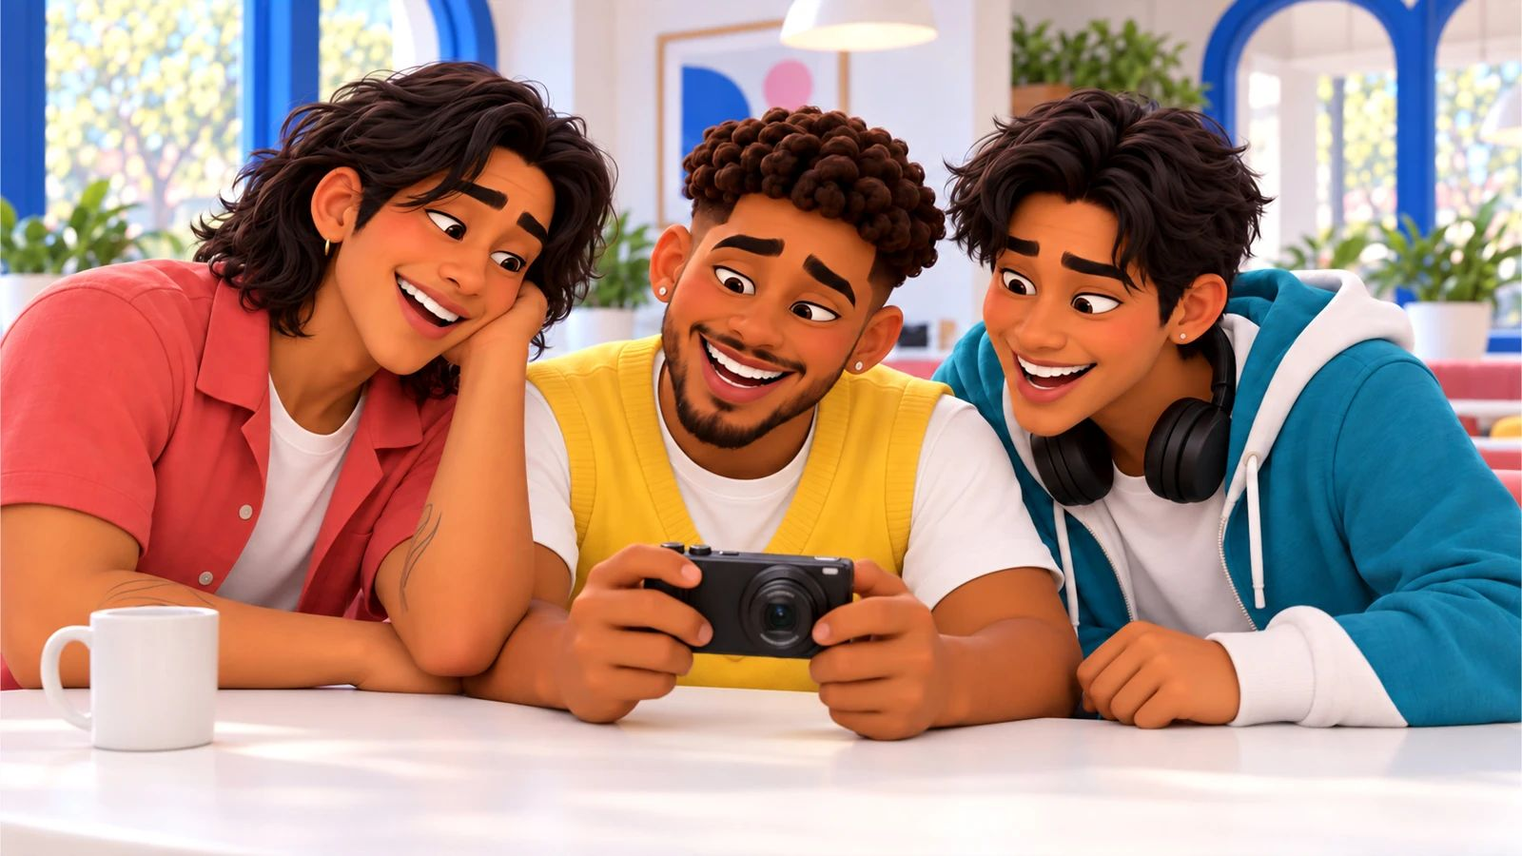
No, Pero Why? · case starter deck
Is it a recommendation or an ad?
If a creator got the product free, do viewers need to know?

Slide 2
The moment
What happened, and why it matters
Much of what students see online is shaped by relationships between creators and brands, and many students are creators too. Knowing what a clear disclosure looks like helps them judge recommendations and post honestly, whether they have fifty followers or fifty thousand.
Caio
“Calma, the cut is good. Watch it once like a stranger with the sound off. Can they tell the book was free?”
Speaker notes: in one sentence, say what happened. Then say what we still don’t know.

Slide 3
The evidence
What we can actually look at
Email · fictional case material
Publisher email offering a review copy
What did the publisher give, and what did they ask for?
Your note:
Post · fictional case material
Gia’s review video, first cut
Where in this video would a viewer learn about the free copy?
Your note:
Draft · fictional case material
Caio’s edit notes
What does Caio want to test before uploading?
Your note:

Slide 4
Words that do the work
Say it plainly
Material connection · Conexión material
A relationship with a brand, like payment or a free product, that could affect how viewers weigh a recommendation.
Disclosure · Divulgación
A clear statement of that relationship, placed where viewers will notice it.
Channel · Canal
The place and format a message travels through, which shapes who sees it.
Consistency · Coherencia
Making sure a message says the same thing across every place it appears.

Slide 5
Your call
If a creator got the product free, do viewers need to know?
My claim
Type here.
Because the evidence shows…
Type here.
Who lives with this choice
Type here.

Slide 6
Take it off the page
Check the relationship before you trust the review.
1. Next time you see a recommendation, look for a disclosure in the video itself
2. If you post reviews, practice a clear spoken line like “They sent me this for free”
3. Share a disclosure checklist with a school media club
4. Don’t accuse real creators; practice on your own or fictional posts

Slide 7
Real sources
Check it yourself
Influencers warned by FTC over ‘inadequate’ disclosures of artificial sweetener promotions (NBC News, 2023-11-15)
https://www.nbcnews.com/news/us-news/ftc-influencer-warning-disclosures-artificial-sweetener-promos-rcna125396
Popular YouTuber chimes in on federal product disclosure guide for influencers (ABC News, 2019-11-06)
https://abcnews.com/US/popular-youtuber-chimes-federal-product-disclosure-guide-influencers/story?id=66790529
FTC crackdown could change influencer marketing for food and beverages (Food Dive, 2023-11-27)
https://www.fooddive.com/news/ftc-crackdown-could-change-influencer-marketing-for-food-and-beverages/700371/
FTC Warns Two Trade Associations and a Dozen Influencers About Social Media Posts Promoting Consumption of Aspartame or Sugar (Federal Trade Commission, 2023-11-14)
https://www.ftc.gov/news-events/news/press-releases/2023/11/ftc-warns-two-trade-associations-dozen-influencers-about-social-media-posts-promoting-consumption
Federal Trade Commission Announces Updated Advertising Guides to Combat Deceptive Reviews and Endorsements (Federal Trade Commission, 2023-06-28)
https://www.ftc.gov/news-events/news/press-releases/2023/06/federal-trade-commission-announces-updated-advertising-guides-combat-deceptive-reviews-endorsements
Effects of social media sponsorship disclosure on adolescents’ advertising literacy and purchase intention (PLOS One (Lin et al.), 2026-05-27)
https://doi.org/10.1371/journal.pone.0348505

