Slide 1
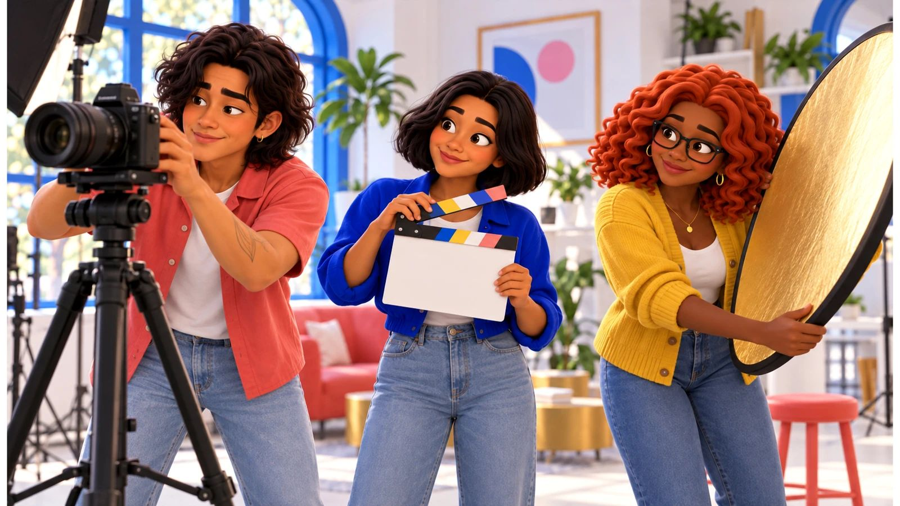
No, Pero Why? · case starter deck
Credit is not the whole copyright answer
If you credit the artist, can you use their track in your film?

Slide 2
The moment
What happened, and why it matters
Students remix music, clips and images every day, and many believe credit or “only ten seconds” makes any use okay. Understanding how U.S. copyright and fair use actually work lets creators share their projects without getting taken down, and respect other creators too.
Caio
“Calma, Mateo. The sample makes the scene, I know. But “we credited them” isn’t a reason I can explain. Let’s check the license first.”
Speaker notes: in one sentence, say what happened. Then say what we still don’t know.

Slide 3
The evidence
What we can actually look at
Draft · fictional case material
Caio’s rough cut with the sampled track
Which parts of this cut did the crew not make?
Your note:
Chat · fictional case material
Mateo: “we’ll credit them, post tonight?”
Which question does credit answer, and which doesn’t it?
Your note:
Form · fictional case material
Rights log template
What goes in the permission column for each clip?
Your note:

Slide 4
Words that do the work
Say it plainly
Copyright · Derechos de autor
U.S. legal protection that automatically covers original creative work once it’s fixed, like recorded or written down.
Attribution · Atribución
Naming or crediting the source.
License · Licencia
Permission to use a work under specific terms.
Fair use · Uso justo
A U.S. doctrine allowing some unlicensed uses, judged case by case on four factors.

Slide 5
Your call
If you credit the artist, can you use their track in your film?
My claim
Type here.
Because the evidence shows…
Type here.
Who lives with this choice
Type here.

Slide 6
Take it off the page
Start a rights log for your next project.
1. List every outside clip, image, sound and quote before you edit
2. Record the source and the license or permission for each
3. Use your school’s licensed media or openly licensed libraries when you can
4. Ask your media teacher or librarian about uses you’re unsure of

Slide 7
Real sources
Check it yourself
Copyright, Exceptions, and Fair Use: Crash Course Intellectual Property #3 (CrashCourse (YouTube), 2015-05-07)
https://www.youtube.com/watch?v=Q_9O8J9skL0
Supreme Court sides against Andy Warhol Foundation in copyright infringement case (NPR, 2023-05-18)
https://www.npr.org/2023/05/18/1176881182/supreme-court-sides-against-andy-warhol-foundation-in-copyright-infringement-cas
TikTok removes music from UMG artists, including Olivia Rodrigo and Taylor Swift (NPR, 2024-02-01)
https://www.npr.org/2024/02/01/1228333611/tiktok-removes-music-from-umg-artists-including-olivia-rodrigo-and-taylor-swift
How Universal's licensing pullout is affecting music on TikTok (The Christian Science Monitor, 2024-02-06)
https://www.csmonitor.com/Arts-Culture/Music/2024/0206/TikTok-and-a-major-label-are-in-a-standoff.-How-does-this-song-end
What Happened When TikTok Songs Went Silent for Three Months (Harvard Business School Working Knowledge, 2025-03-05)
https://www.library.hbs.edu/working-knowledge/what-happened-when-tiktok-songs-went-silent-for-three-months
Andy Warhol Found. for the Visual Arts, Inc. v. Goldsmith (Fair Use Index summary) (U.S. Copyright Office, 2023)
https://www.copyright.gov/fair-use/summaries/Andy-Warhol-Found-for-the-Visual-Arts-Inc-v-Goldsmith-143-S-Ct-1258-2023.pdf

