Slide 1
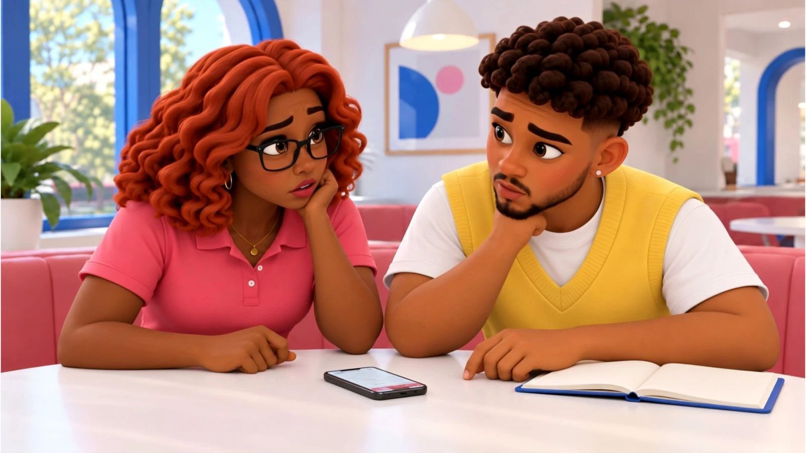
No, Pero Why? · case starter deck
Before you repost
What can a screenshot actually prove?

Slide 2
The moment
What happened, and why it matters
Most news about school closures, rule changes and events reaches students as a cropped clip in a group chat. Checking the original and posting a useful update keeps a whole community from acting on half a sentence.
Mateo
“Dale, I wanted it to be good news so badly I almost posted that. Let me find the full transcript first.”
Speaker notes: in one sentence, say what happened. Then say what we still don’t know.

Slide 3
The evidence
What we can actually look at
Chat · fictional case material
Group-chat screenshot with attached clip
What was said right after this clip ends?
Your note:
Notice · fictional case material
Coordinator’s meeting transcript
Which four words narrow what “access” means?
Your note:
Email · fictional case material
Booking confirmation sent to Mateo
What does this confirm, and what does it not say about the side door?
Your note:

Slide 4
Words that do the work
Say it plainly
Claim · Afirmación
Something a person says is true. It still needs checking before you repeat it.
Context · Contexto
The information around a quote or clip that changes what it means.
Primary source · Fuente primaria
The original record of what was said or done, not someone’s retelling of it.
Holding statement · Declaración provisional
A short message saying what you know, what you are checking and when you will update.

Slide 5
Your call
What can a screenshot actually prove?
My claim
Type here.
Because the evidence shows…
Type here.
Who lives with this choice
Type here.

Slide 6
Take it off the page
Find out how your school sends urgent updates.
1. Ask a teacher or front-office staff which channel carries official changes (email, app, website)
2. Save the official channel so you can check it before reposting
3. Next time a screenshot circulates, post “still checking” instead of a verdict
4. Suggest to your student council that urgent updates include the original link

Slide 7
Real sources
Check it yourself
Check Yourself with Lateral Reading: Crash Course Navigating Digital Information #3 (CrashCourse (YouTube), 2019-01-22)
https://www.youtube.com/watch?v=GoQG6Tin-1E
Viral image shows fake story from The Atlantic about Biden (PolitiFact, 2022-08-01)
https://www.politifact.com/factchecks/2022/aug/01/viral-image/viral-image-was-manipulated-show-fake-story-atlant/
Lesson plan: How to spot fake screenshots on social media (PBS NewsHour Classroom, 2022-11-17)
https://www.pbs.org/newshour/classroom/lesson-plans/2022/11/lesson-plan-how-to-spot-fake-screenshots-on-social-media
High school students are unprepared to judge the credibility of information on the internet, according to Stanford researchers (Stanford Graduate School of Education, 2019-11-18)
https://ed.stanford.edu/news/high-school-students-are-unprepared-judge-credibility-information-internet-according-stanford
It doesn’t take long to learn how to spot misinformation online, Stanford study finds (Stanford Graduate School of Education, 2022-04-19)
https://ed.stanford.edu/news/it-doesn-t-take-long-learn-how-spot-misinformation-online-stanford-study-finds
Lateral reading on the open Internet: A district-wide field study in high school government classes (Journal of Educational Psychology (Wineburg et al.), 2022-07)
https://doi.org/10.1037/edu0000740

