Slide 1
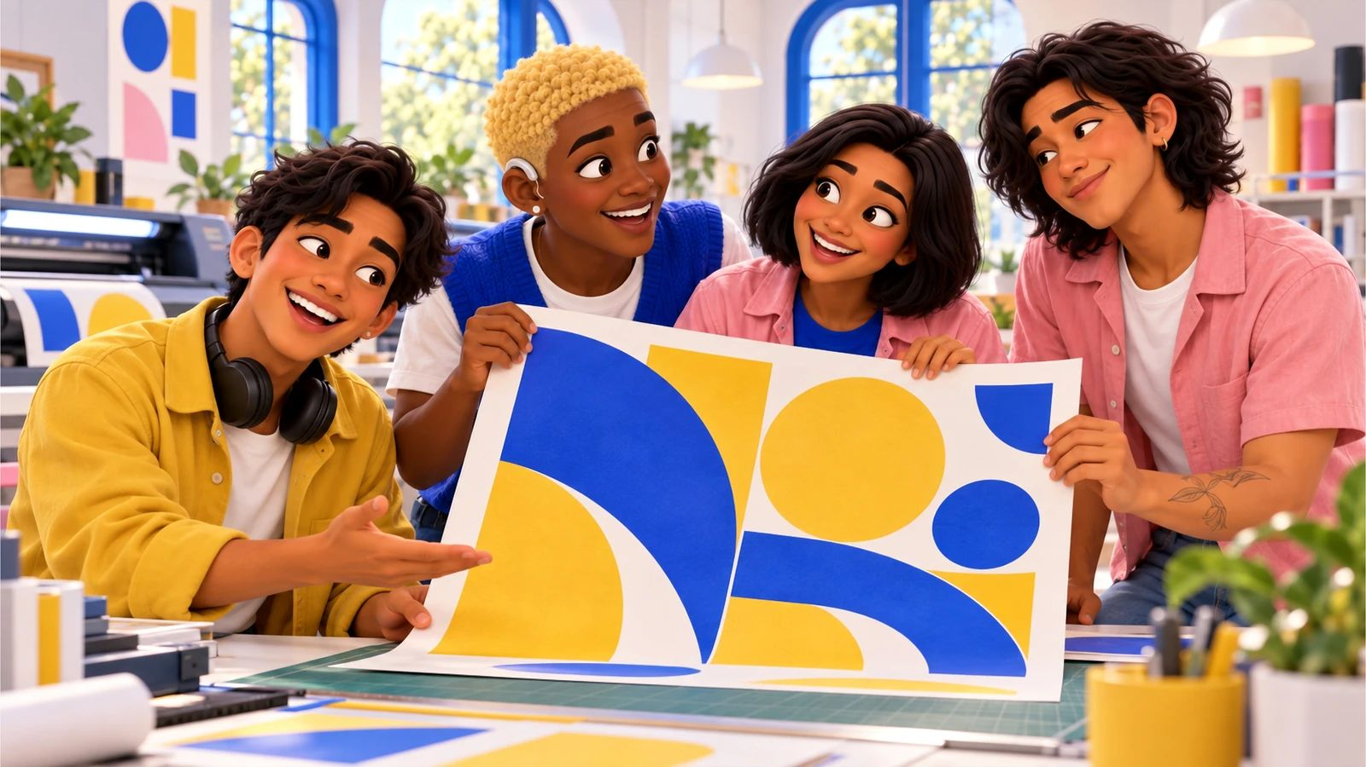
No, Pero Why? · case starter deck
Before it reaches the bin
Could the crew make less waste before anyone reaches the recycling bin?

Slide 2
The moment
What happened, and why it matters
Cities spend public money collecting and managing waste, and the costs of landfills and pollution don’t land evenly on every neighborhood. Students who look upstream at what gets bought and reused can make real changes at school events and ask better questions of their local government.
Dec
“Half this box is packaging around tiny parts. Before we redo the recycling sign, can we just order smarter?”
Speaker notes: in one sentence, say what happened. Then say what we still don’t know.

Slide 3
The evidence
What we can actually look at
Form · fictional case material
Parts order with packaging
What could the next order change?
Your note:
Notice · fictional case material
City accepted-materials list (illustrative)
Does this list accept the cups the crew bought?
Your note:
Budget · fictional case material
Screening supply list
Which item was used the most, and could it be reused?
Your note:

Slide 4
Words that do the work
Say it plainly
Waste hierarchy · Jerarquía de residuos
EPA’s ranking that generally prefers reducing and reusing before recycling, and recycling before disposal.
Source reduction · Reducción en la fuente
Preventing waste before it’s created, like buying less or choosing less packaging.
Local acceptance · Materiales aceptados
What your local collection program actually takes, which varies by city.
Public service · Servicio público
A service government provides for everyone, like trash and recycling pickup, paid for with public money.

Slide 5
Your call
Could the crew make less waste before anyone reaches the recycling bin?
My claim
Type here.
Because the evidence shows…
Type here.
Who lives with this choice
Type here.

Slide 6
Take it off the page
Change one thing before the next event.
1. Pick one repeated item at a school event: cups, flyers, plates
2. Count how many were used last time
3. Check your city’s recycling list and propose one reduction or reuse option
4. Count again after the event and share results with the organizers

Slide 7
Real sources
Check it yourself
How Big Oil Misled The Public Into Believing Plastic Would Be Recycled (NPR, 2020-09-11)
https://www.npr.org/2020/09/11/897692090/how-big-oil-misled-the-public-into-believing-plastic-would-be-recycled
How New Jersey Schools Are Tackling Food Waste—One Tray at a Time (New Jersey School Boards Association, 2025-10-15)
https://www.njsba.org/news-information/school-leader/how-new-jersey-schools-are-tackling-food-waste-one-tray-at-a-time/
Share tables reduce food waste (California School Boards Association, 2023-10-13)
https://publications.csba.org/california-school-news/october-2023/share-tables-reduce-food-waste/
Plastic Wars (full documentary) | FRONTLINE (FRONTLINE PBS (YouTube), 2020-03-31)
https://www.youtube.com/watch?v=-dk3NOEgX7o
Wasted Food Scale (U.S. Environmental Protection Agency, n.d. (last updated 2026-09-16))
https://www.epa.gov/sustainable-management-food/wasted-food-scale
Review of Schools’ Food Donation and Composting Efforts (MH25-077S) (Office of the New York City Comptroller, 2026-04-21)
https://comptroller.nyc.gov/reports/review-of-schools-food-donation-and-composting-efforts/

