Slide 1
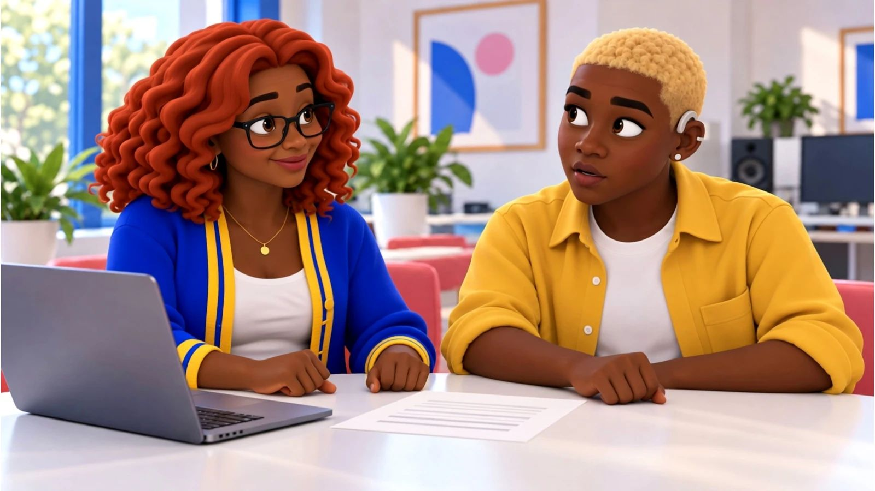
No, Pero Why? · case starter deck
The apology is not the repair
What makes a correction more useful than “sorry”?

Slide 2
The moment
What happened, and why it matters
Clubs, schools and companies all post things that turn out to be wrong, and how they fix it decides who keeps trusting them. Students who can tell a real correction from a nice-sounding apology can hold groups, including their own, to a higher standard.
Anika
“We were carrying chairs at 5:30. Don’t tell me how sorry you feel. Tell people what actually happened.”
Speaker notes: in one sentence, say what happened. Then say what we still don’t know.

Slide 3
The evidence
What we can actually look at
Post · fictional case material
The published recap caption
Which group does this caption ask readers to blame, and on what evidence?
Your note:
Form · fictional case material
Jordy’s setup log
What happened at 5:40 that the caption never mentions?
Your note:
Draft · fictional case material
Gia’s first correction (not posted)
What fact does this apology actually correct?
Your note:

Slide 4
Words that do the work
Say it plainly
Communications plan · Plan de comunicación
A plan naming your goal, audiences, key message, channels and how you will check it worked.
Key message · Mensaje clave
The one idea every audience should walk away with.
Correction · Corrección
A clear replacement of inaccurate information, published where the error was seen.
Stereotype · Estereotipo
A broad assumption about people because of a group label.

Slide 5
Your call
What makes a correction more useful than “sorry”?
My claim
Type here.
Because the evidence shows…
Type here.
Who lives with this choice
Type here.

Slide 6
Take it off the page
Help a club you’re in write a corrections rule.
1. Ask the editor or advisor of a school newsletter, club account or yearbook how they fix mistakes
2. Suggest a three-step checklist: name the error, show the evidence, say what changes
3. Offer to test it on an old post together
4. Keep any real examples anonymous

Slide 7
Real sources
Check it yourself
That was wrong (NPR Public Editor, 2022-10-21)
https://www.npr.org/sections/publiceditor/2022/10/21/1130472094/that-was-wrong
Dove Expresses 'Regret' For Racially Insensitive Ad (NPR, 2017-10-08)
https://www.npr.org/sections/thetwo-way/2017/10/08/556523422/dove-expresses-regret-for-ad-that-missed-the-mark
H&M hires diversity leader after outrage over 'monkey hoodie' ad (NBC News, 2018-01-17)
https://www.nbcnews.com/news/nbcblk/after-backlash-over-monkey-hoodie-ad-h-m-hires-diversity-n838361
Dove apologizes for racially insensitive ad (CBS News (YouTube), 2017-10-08)
https://www.youtube.com/watch?v=fhSQckdQkMQ
The 6 elements of an effective apology, according to science (The Ohio State University News, 2016-04-12)
https://news.osu.edu/the-6-elements-of-an-effective-apology-according-to-science/
An Exploration of the Structure of Effective Apologies (Negotiation and Conflict Management Research (Lewicki et al.), 2016-04-06)
https://doi.org/10.1111/ncmr.12073

